Slide 1
Health Care Homes
Practice ownership and business models
The unspoken issues and what we can do about them

Slide 2
Outcomes
Recognise how some General Practice ownership and business models can limit Health Care Home development.
Know when it’s the right time to talk ownership and business model with practices.
Consider what support practices need to change and grow.

Slide 3
Ownership and business models
 | Old | 2015 – as reported by MAS | Now (2019)
Business structure | Group practice – mostly cost sharing | Single business, profit sharing becoming more common. | Still mostly group practice cost sharing – but a few more profit sharing.
Facilities | Often converted house | IFHC developments becoming more common. | More IFHCs / new facilities. Still a lot of old.
Practice values | Limited value | Generally limited value | IFHCs / amalgamated practices valued more highly 1 – 2 million.
Revenue streams | Majority from patients | Over 60% from government through capitation and ACC etc | Majority through capitation / ACC, plus other variable revenue streams such as HCH.
Revenue generators | Income generated by GP face to face consultation | Income generated by other staff such as nurses via consultations. | Revenue generated via F2F, virtual consultations. GP, Nurse, HCA and allied health

Slide 4
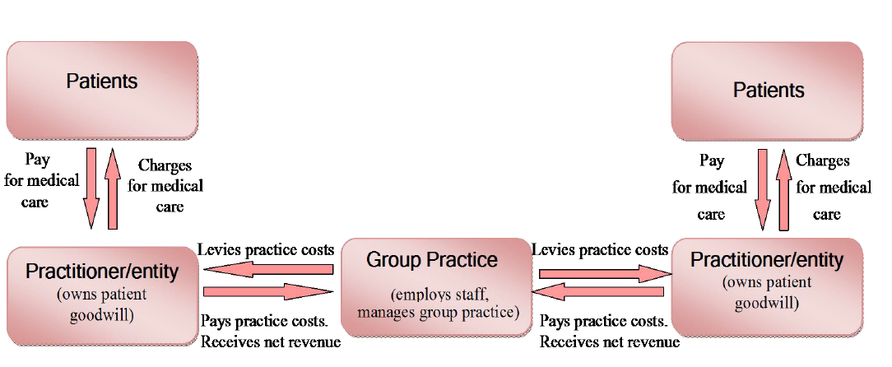
Typical cost share model (from MAS 2015)

Slide 5
Change is critical and will take time
Health Care Home will stagnate
Health Care Home will flourish
Cost share model
Profit sharing single entity

Slide 6
The problem with cost sharing
Remuneration models focuses on GP throughput.
Generally there is a lack of investment and capital.
Management and Boards can’t easily make decisions around forward thinking or use of profits.
Limited ability for succession planning – workforce wanting more flexible arrangements.
Mergers are often the answer but require investment. No equity = no investment. Raising capital is the only way.
GP owners don't trust any other way of generating revenue, other than selling their own time.
Difficult to take control of the long term future of the Practice.
Many GPs are locked into cost sharing arrangement and cannot sell.

Slide 7
Operational impact – cost share
HCA / Nurses can do medicals
- … who gets the income? GP better just keep doing it.
LTC Nurse can see high risk patients
- … my practice doesn’t have as many high needs so that’s not fair. We could split the cost of the nurse, and the income.
Maori and High Needs patients have 30 minute appointments
- But my practice has so many Maori and High Need. I’ll earn less if I do more longer appointments.
Patients can get pre-work with the HCA.
- Who gets the income? Shared evenly across partners?
Some GPs will do extended hours for routine appointments
- But that means the practice is open longer and costs will go up. Who pays the extra cost? Shall we calculate it and apportion more costs to them?
Etc…. Too hard. Let’s carry on as we are

Slide 8
Myths to bust
Young GPs are not interested in ownership.
My patient base (capitation and fees), is worth more than others.
Other partners in my practice don’t work as hard as me
I’m too old to take on any debt.
We can’t afford to form a single entity and buy all the practices

Slide 9
Health Care Homes need
Forward thinking, planning.
Investment in infacilities, technology and infrastructure
Team based activity.
Multidisciplinary / Interdisciplinary teams.
Bulk funding.
System level thinking – whole of practice, whole of system.
‘Wet’ shareholders.
Excellent corporate governance.
Succession planning for new GPs.

Slide 10
So where to from here?
Develop long term, whole of company thinking.
Make decisions about the culture and vision of the whole company.
Create value in the company rather than the individual/s.
Retain some capital.
Develop model where GPs benefit from being owners – but allow the company to grow.
Separate clinical and shareholder remuneration.
Often decisions about ownership will come up around time of infrastructure change – eg new buildings etc. Be ready for these.

Slide 11
Thank you
+64 212740012
nicky.hart@fhc.nz
feildinghealthcare.nz

