Slide 1
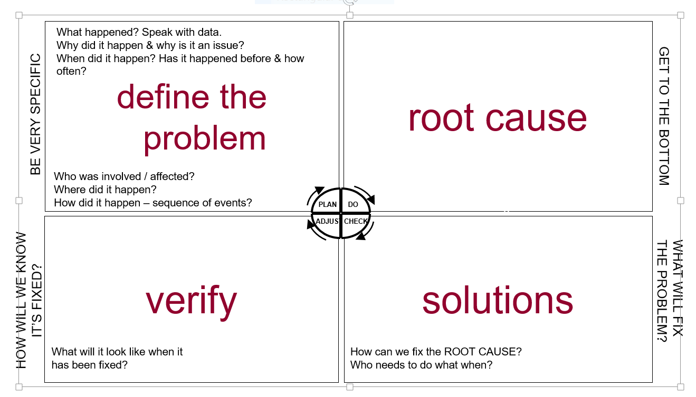
Structured problem solving template

Slide 2
Ishikawa or fishbone diagram

