Slide 1
Lance Norman
Ngāti Kuri

Slide 2
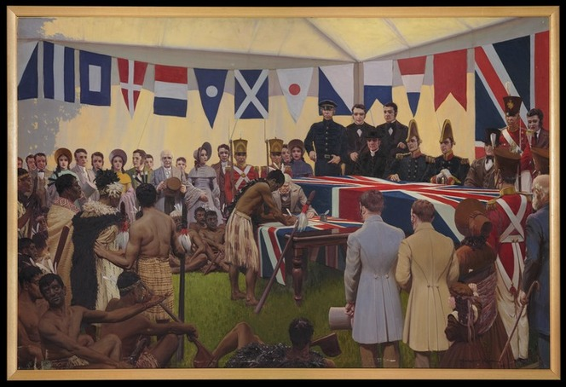
Te Tiriti o Waitangi – 6 February 1840

Slide 4
Key differences
Land Ownership
Governance
Article one: For Māori it meant that Queen Victoria had shared use of the land, while for English it gave her sovereignty over the land, which is a stronger ownership term.
Article two: The Māori version guaranteed chiefs ‘te tino rangatiratanga’ – chieftainship over their lands, villages and treasured things. It also gave the Crown a right to deal with Māori in buying land. The English version gave chiefs ‘exclusive and undisturbed possession’ of lands, forests, fisheries and other property. It also gave the Crown an exclusive right to deal with Māori over buying land.
Article three: Both versions gave Māori the Queen’s protection and the rights of British subjects.

Slide 5
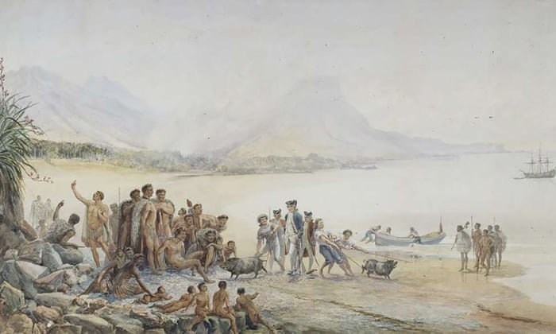
Colonisation

Slide 6
New Zealand Settlement Act of 1863

Slide 7
Colonisation
Introduction of health issues not previously known to Māori
Alcohol and Tobacco Addictive Products
Sugary foods Diabetes/Cardiovascular Disease
Diseases for which they had no resistance eg, the flu
Significant loss of land/economic asset for Māori
Myth: “You got your land back”
Fact: Land was proven to have been illegally confiscated by the Crown (Queen Victoria’s Law) and therefore deemed to be required to be returned to Māori – please don’t say that statement like: “You ought to be grateful”
Fact: The value of returned assets was significantly less than the value of the illegally confiscated land, for example:
Tainui Iwi – land confiscated = approximately $18 billion
Treaty Settlement = $170 million = 2% of economic value
Fact: This settlement process was almost 150 years after the confiscation (Tainui example 1860 – 1985)
The result of this is a massive loss of an economic and cultural resource over a significant period of time

Slide 8
Native Schools Act (1867) decrees that English should be the only language used in the education of Māori children.” The policy is later rigorously enforced.
The native schools system was in action from 1867 to 1969.
Te Taura Whiri I te Reo Māori – Māori Language Commission

Slide 9
The Māori language was suppressed in schools, formally and informally, to ensure that Māori youngsters assimilated with the wider community.”
https://www.lawsociety.org.nz/news-and-communications/latest-news/news/history-of-te-reo-mori-in-the-courts

Slide 10
The Act contained only four clauses, the first of which simply gave the short title. The second clause stated that “every person who gathers Māori around him by practising on their superstition or credulity, or who misleads or attempts to mislead any Māori by professing or pretending to possess supernatural powers in the treatment or cure of any disease, or in the foretelling of future events, or otherwise," was liable for prosecution. The first offence could be subject to a fine of up to 25 pounds or up to six months imprisonment.”
Tohunga Suppression Act 1907

Slide 11
Plunket Society Established. From its establishment, the Plunket Society specifically excluded Māori from its client base, despite their arguably having the highest need for such services. Māori were not provided with full access to Plunket services until some 70 years later.”
1907 – Māori infants refused access to adequate healthcare services.
Mauri Ora Health Education Research: https://members.mauriora.co.nz/treaty-time-line/

Slide 12
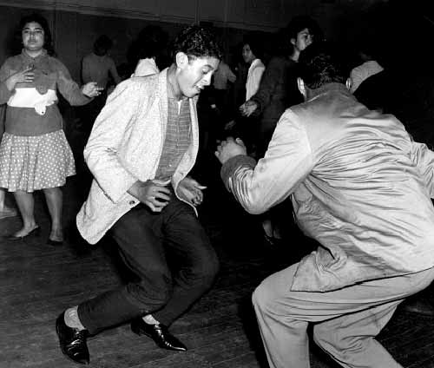
Urbanisation

Slide 13
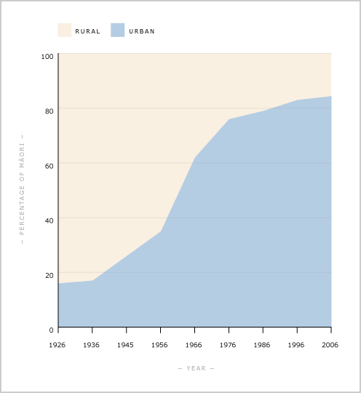
Urbanisation
Māori urbanised faster than any other indigenous group on the planet.
Prior to 1966, more Māori lived in rural areas – Far North, East Coast, Whanganui.
There was a “second migration” to cities for education, employment opportunities, in some instances government policies moved people away from resource rich areas, or into lower socio- economic areas.
Ministry for Culture and Heritage

Slide 14
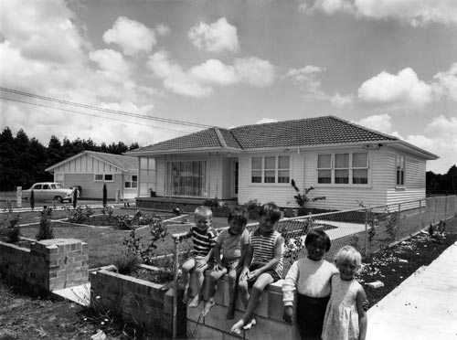
Issue around urbanisation
The following extract from a 2000 High Court of New Zealand judgment (discussing the process of settling fishing rights) some of the issues of urbanisation:
“81 percent of Māori now live in urban areas, at least one-third live outside their tribal influence, more than one-quarter do not know their iwi or for some reason do not choose to affiliate with it, at least 70 percent live outside the traditional tribal territory and these will have difficulties, which in many cases will be severe, in both relating to their tribal heritage and in accessing benefits from the settlement.”
In the 2006 census, 16 per cent of the 643,977 people who claimed Māori ancestry did not know their Iwi. Another 11 per cent did not state their Iwi, or stated only a general geographic region, or merely gave a waka name.

Slide 15
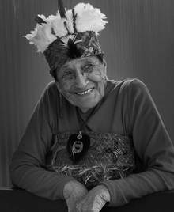
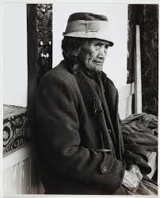
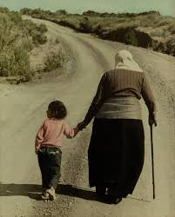
Urbanisation
The result of urbanisation was a significant loss of connectivity to Kuia and Kaumatua who would have installed traditional values inclusive of:
Looking after our wāhine
Looking after our tamariki
Looking after our whānau
Looking after ourselves
Looking after our environment
Urbanisation had a significant impact on our value system:
85% of all Māori now live in an urban environment
70% of all Māori now live outside of traditional Iwi boundaries (rohe)
25% of all Māori now live in Auckland

Slide 16
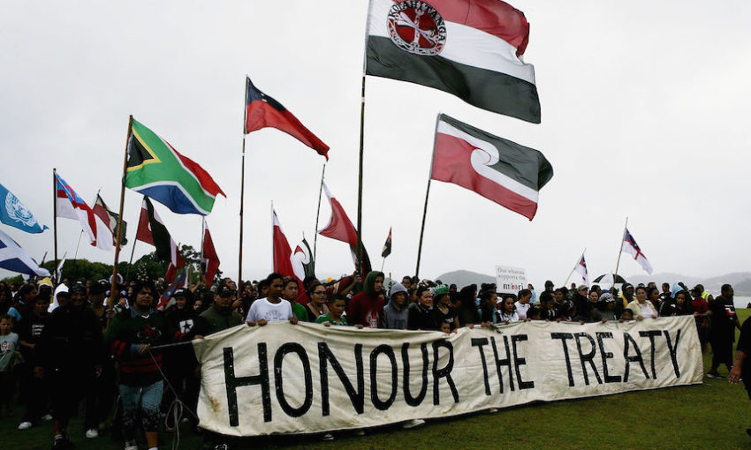
Marginalisation

Slide 17
Marginalisation
Māori are over-represented negatively in all of the following health categories:
Cardiovascular Disease | Mental Health
Diabetes | Suicide
Drug and Alcohol abuse | Problem Gambling
Smoking | Immunisations
Cervical Cancer | Respiratory issues
Bowel Cancer | Dental Care
Prostate Cancer Enrolment with General Practices | Avoidable Hospitalisations

Slide 18
Marginalisation
Māori are over-represented negatively in these socio-economic categories:
Unemployment | Racism
Homelessness | Gang affiliation
Poverty | Racial profiling
Incarceration | Home ownership
Domestic violence | Participation in civil processes
New Zealand has data on all these areas and subsequent Governments have not established policies to address these issues.

Slide 19
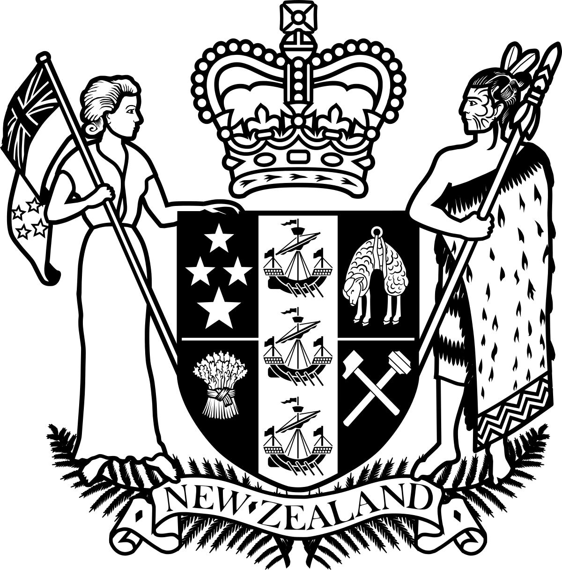
New Zealand Public Health & Disability Act 2000

Slide 20
New Zealand Public Health & Disability Act 2000
Purpose
The purpose of this Act is to provide for the public funding and provision of personal health services, public health services, and disability support services, and to establish new publicly-owned health and disability organisations, in order to pursue the following objectives:
(a) to achieve for New Zealanders—
(i) the improvement, promotion, and protection of their health:
(ii)the promotion of the inclusion and participation in society and independence of people with disabilities:
(iii)the best care or support for those in need of services:
(b) to reduce health disparities by improving the health outcomes of Māori and other population groups.

Slide 21
Example of Treaty clause in DHB contracts
A1 Treaty of Waitangi and Māori health statement The Treaty of Waitangi establishes the unique and special relationship between iwi Māori and the Crown. As a Crown entity, the Counties Manukau District Health Boards (DHB) considers the Treaty of Waitangi principles of partnership, proactive protection of Māori health interests, cooperation and utmost good faith, to be implicit conditions of the nature in which the internal organisation of the Ministry of Health responds to Māori health issues.
Equally Counties Manukau DHB expects providers to apply these principles in their relationship with their clientele. Therefore, all agreemented providers whose clients may include Māori, must be able to demonstrate how their policies and practices shall benefit the health outcomes of their Māori clientele.
A3 Māori health priority A3.1 You agree that Māori health is a specifically identified health gain priority area. You must therefore establish and implement a Māori health policy that reflects that fact. In developing this policy, you must take into account any Māori strategy issued by the Minister of Health.
A3.2 You must specify how you intend to implement this policy. In particular, you will need to identify those services you will deliver as explicit contributions to Māori health gain priorities, how these services will be measured to ascertain what benefit is evident and other additional opportunities that may exist for furthering Māori health gain.

Slide 22
Statistics

Slide 23
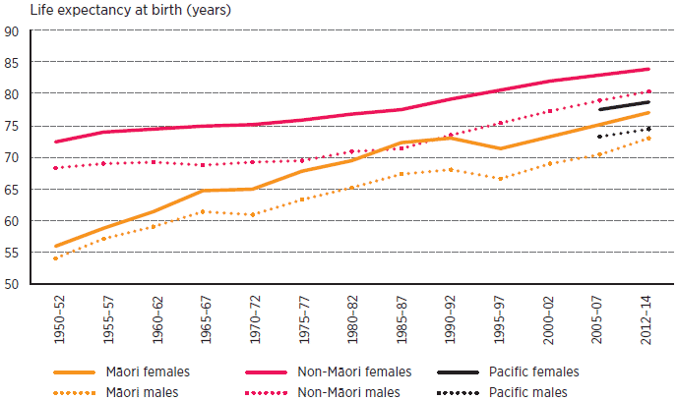
Life Expectancy
https://www.health.govt.nz/new-zealand-health-system/new-zealand-health-strategy-future-direction/challenges-and-opportunities
Notes:
https://www.health.govt.nz/new-zealand-health-system/new-zealand-health-strategy-future-direction/challenges-and-opportunities

Slide 24
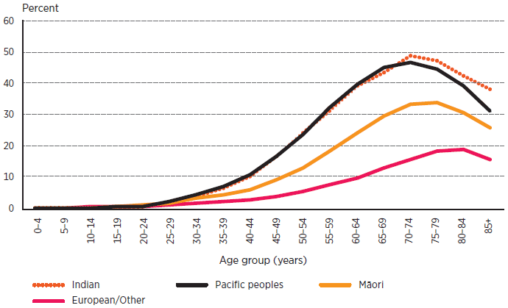
Diabetes
Prevalence of diabetes, by ethnic group and age, 2013
https://www.health.govt.nz/new-zealand-health-system/new-zealand-health-strategy-future-direction/five-strategic-themes/closer-home

Slide 25
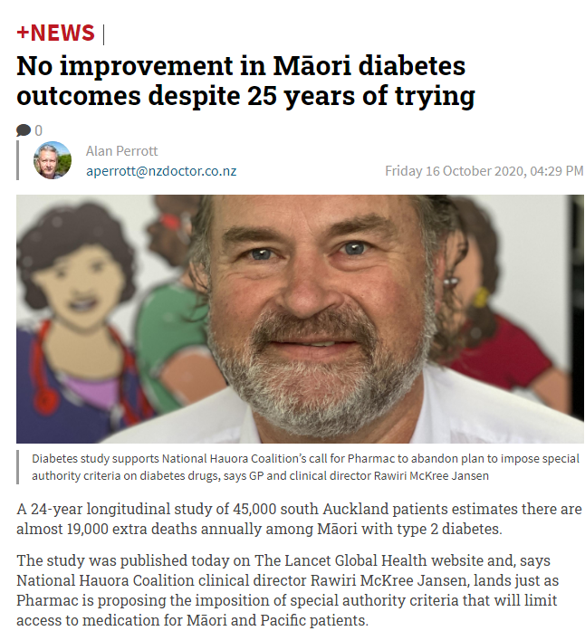
Diabetes

Slide 26
Bowel screening
At least half of Māori bowel cancer (60 percent female and 50 percent male) is diagnosed before the age of 60 years, compared to less than one-third (30 percent) of non-Māori bowel cancer (male and female).
Restricting bowel cancer screening to everyone over 60 years ensures that Māori have less opportunity to benefit from screening as over half of Māori bowel cancer is diagnosed before screening begins.
Furthermore, Māori bowel cancer that is screen diagnosed over the age of 60 may be more advanced than that of their non-Māori peers because of delayed opportunity to identify it by screening earlier.
https://teora.maori.nz/wp-content/uploads/2020/01/Position-Statement-Bowel-Screening.pdf

Slide 27
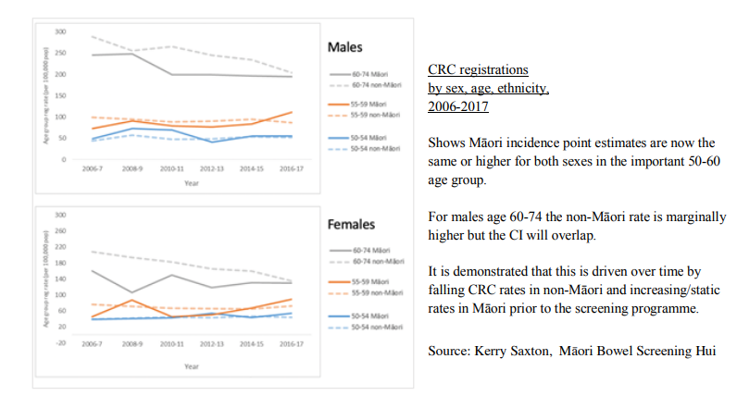
Bowel screening
https://teora.maori.nz/wp-content/uploads/2020/01/Position-Statement-Bowel-Screening.pdf

Slide 28
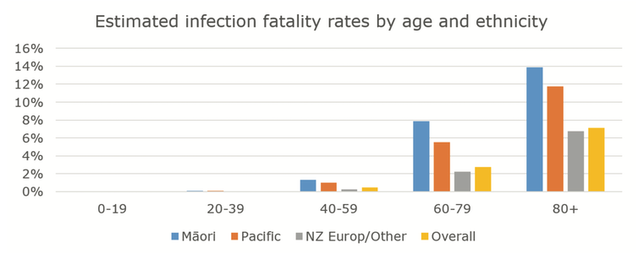
Impact of COVID-19
Research shows Māori are more likely to die from COVID-19 than other New Zealanders.
https://www.nzma.org.nz/journal-articles/estimated-inequities-in-covid-19-infection-fatality-rates-by-ethnicity-for-aotearoa-new-zealand

Slide 29
Impact of COVID-19
During the 2009 influenza pandemic, the rate of infection for Māori was twice that of Pākehā (European New Zealanders). Māori were three times more likely to be hospitalised and almost three times more likely to die. https://theconversation.com/research-shows-maori-are-more-likely-to-die-from-covid-19-than-other-new-zealanders-145453
1918 Influenza (The Spanish Flu) caused 9,000 deaths and Māori deaths accounted for a quarter to a third of the deaths. The fatality rate for Māori was at least seven times that of Pākehā.
https://www.teaomaori.news/1918-influenza-pandemics-devastating-impact-on-maori

Slide 30
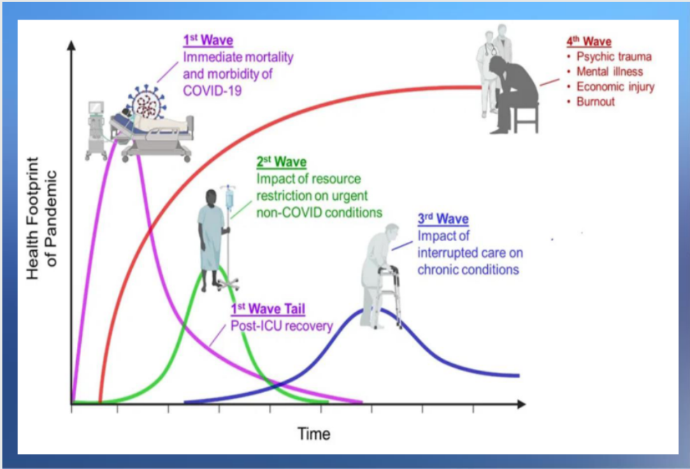
Impact of COVID-19

Slide 31
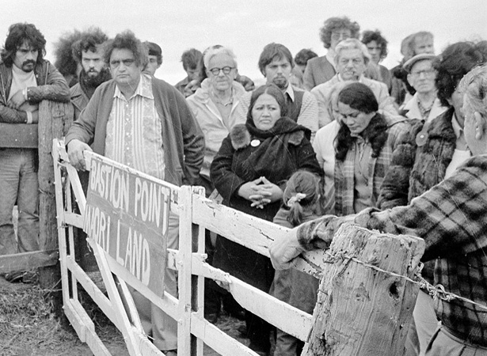
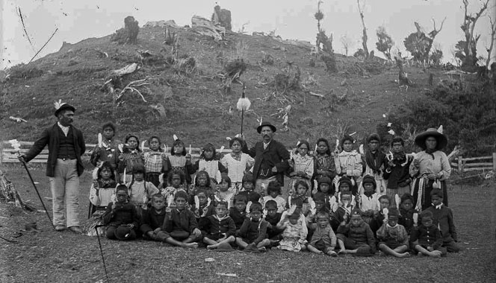
The ‘R’ Word
Let’s not deny racism does exist in New Zealand
Examples:
Māori man steals 10 fish to feed his family and is imprisoned for 12 months.
Young non-Māori people trashed home and caused $200k worth of damage and get home detention.
New Zealanders wearing “Black face” and people think this is acceptable to mock slavery.
When we talk Māori language week – it’s generally okay. When we talk making teaching Te Reo Māori compulsory, it’s not.
Ever been taught about Bastion Point at Ōrākei, or the Waikato Land Wars and the complete annihilation of Parihaka in school?
Targeted funding for Māori is always hard to digest.

Slide 32
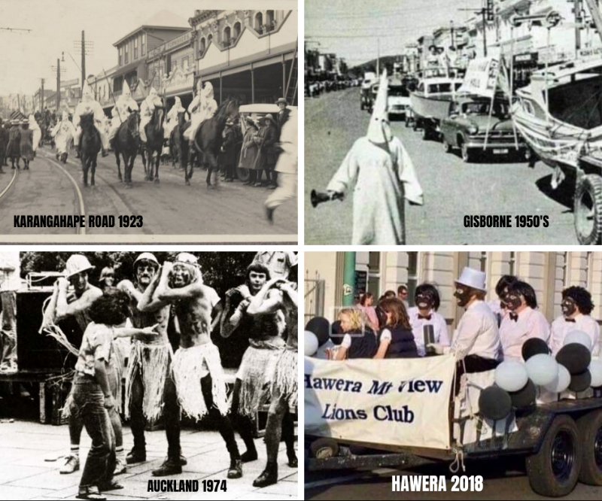
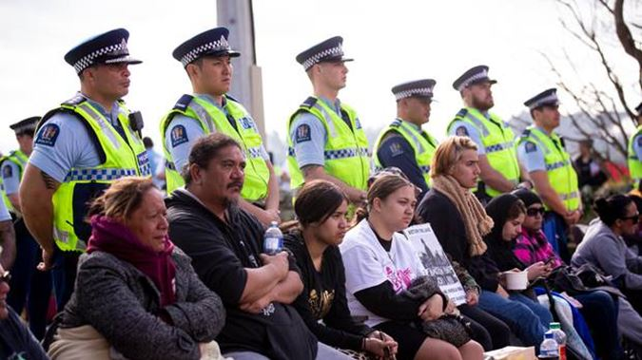
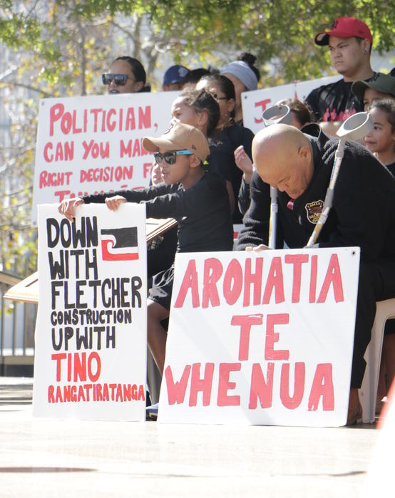
The ‘R’ Word
Let’s not deny racism does exist in New Zealand
Examples:
The moment in 1979 when activist group, He Taua, attacked a group of engineering students as they rehearsed their annual mockery of the haka.
Ihumātao protests led by "Save Our Unique Landscape" (SOUL) of the Fletcher's housing development project which has occupied the site and staged protests since 2016.

Slide 33
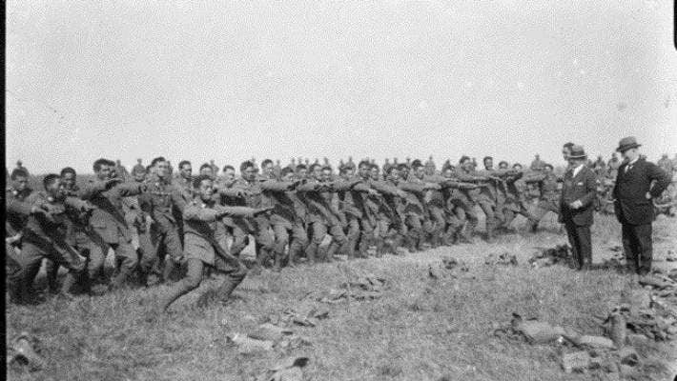
The ‘R’ Word
Let’s not deny racism does exist in New Zealand
Examples:
Māori veterans did not receive the same benefits and entitlements as Pākehā servicemen. They also missed out on receiving equal medical and mental health support.
The electoral franchise established under the 1852 New Zealand Constitution Act was theoretically colour-blind. In reality, though, very few Māori men could qualify under the property requirement because they possessed their lands communally (as iwi, hapu or whānau groups) and not under individual freehold or leasehold title as Europeans did.
1893 Electoral Act gave all New Zealand women the vote, including Māori.
Pioneer Battalion performing a haka for Joseph George Ward at Bois-de-Warnimont in June 1918.
Māori voters at Rotorua, about 1908
Notes:
https://www.stuff.co.nz/national/108363904/maori-soldiers-great-war-battle-for-equality
https://nzhistory.govt.nz/politics/maori-and-the-vote/setting-up-seats

Slide 34
The standard General Practice model of care
This is a generalisation but occurs for many people in our Health System
Non Māori | Māori
Generally own vehicle | May not own a vehicle
GP appointment during lunch break | Solo mum, may have to take annual leave for GP appointment
Positive greeting on arrival | Met with “are you Māori?”
Aware of medical interventions | Low level of health literacy
15 minute consult | 40 minute consult – multiple health issues
Pays co-pay | May not be able to afford
Picks up prescription | May not be able to afford

Slide 35
Let’s pause for a moment.

Slide 36
The positive

Slide 37
Māori education providers
Kōhanga Reo
Kura Kaupapa / Whare Kura
Three Māori Wānanga

Slide 38
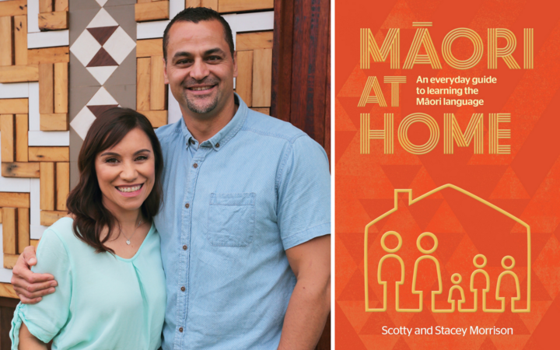
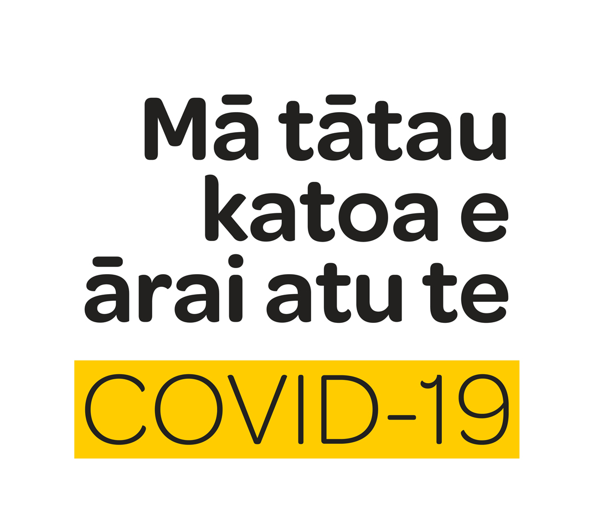
Māori health and social agencies
Māori Wardens
Māori Women’s Welfare League
Te Matatini
Te Reo Māori Revitalisation
Whānau Ora Commissioning Agency
Hāpai Te Hauora - Māori Public Health
Te Rau Ora - Māori Mental Health
Māori COVID-19 response teams

Slide 39
Other positives in health
Very Low Cost Access General Practices ($19.50 co-pay).
Community Services Card ($19.50 co-pay).
Free under 14 for Primary Healthcare.
Free under 18 dental care.
Targeted funding for Māori/Pacific/Q5.
Free hospital services.
ACC covers 80% of your wages if you have an accident at work, at home or playing sport.

Slide 40
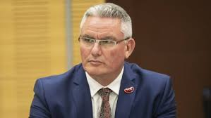
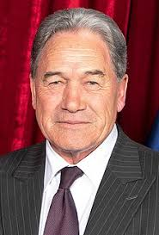
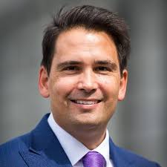
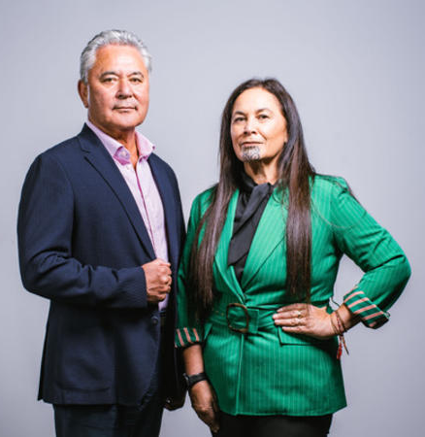
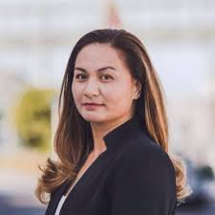
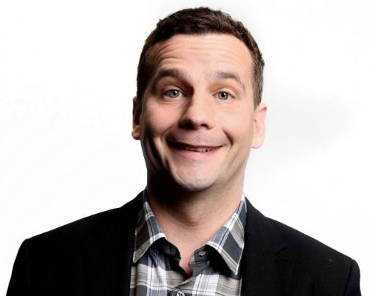
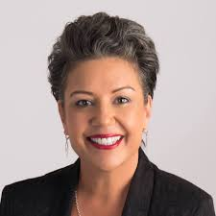
Māori leadership – Political parties
At one point in time, there were a number of prominent Māori leadership in NZ politics

Slide 41
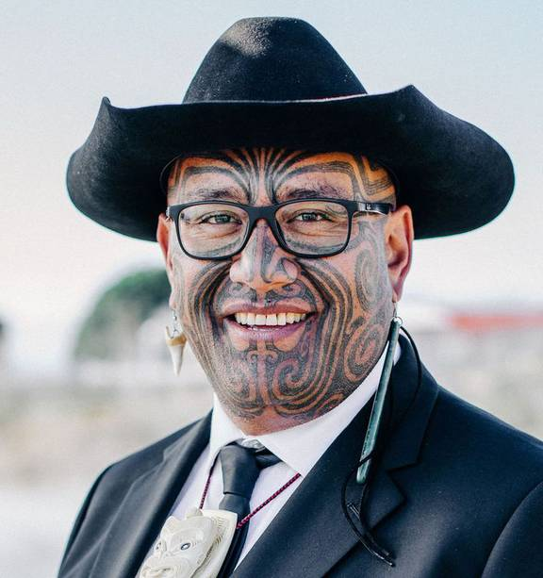
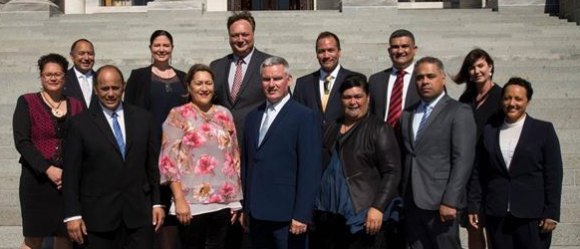
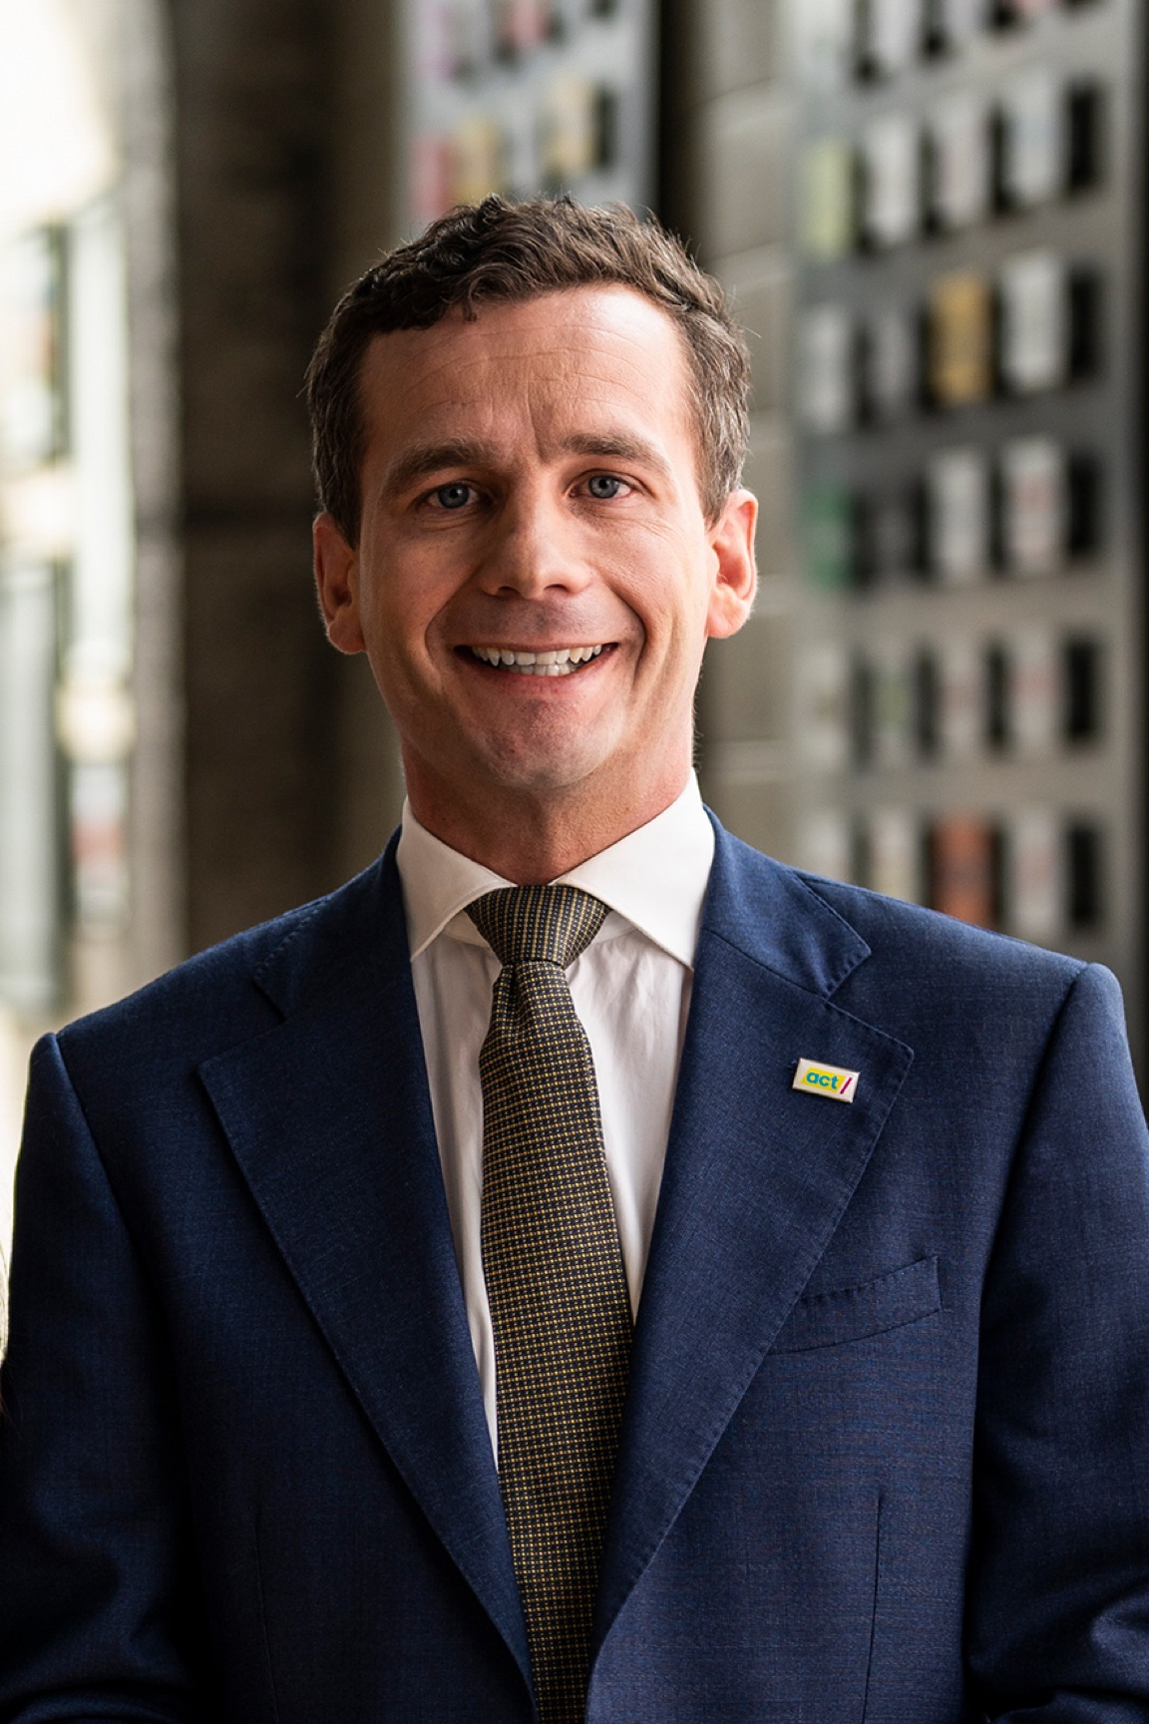
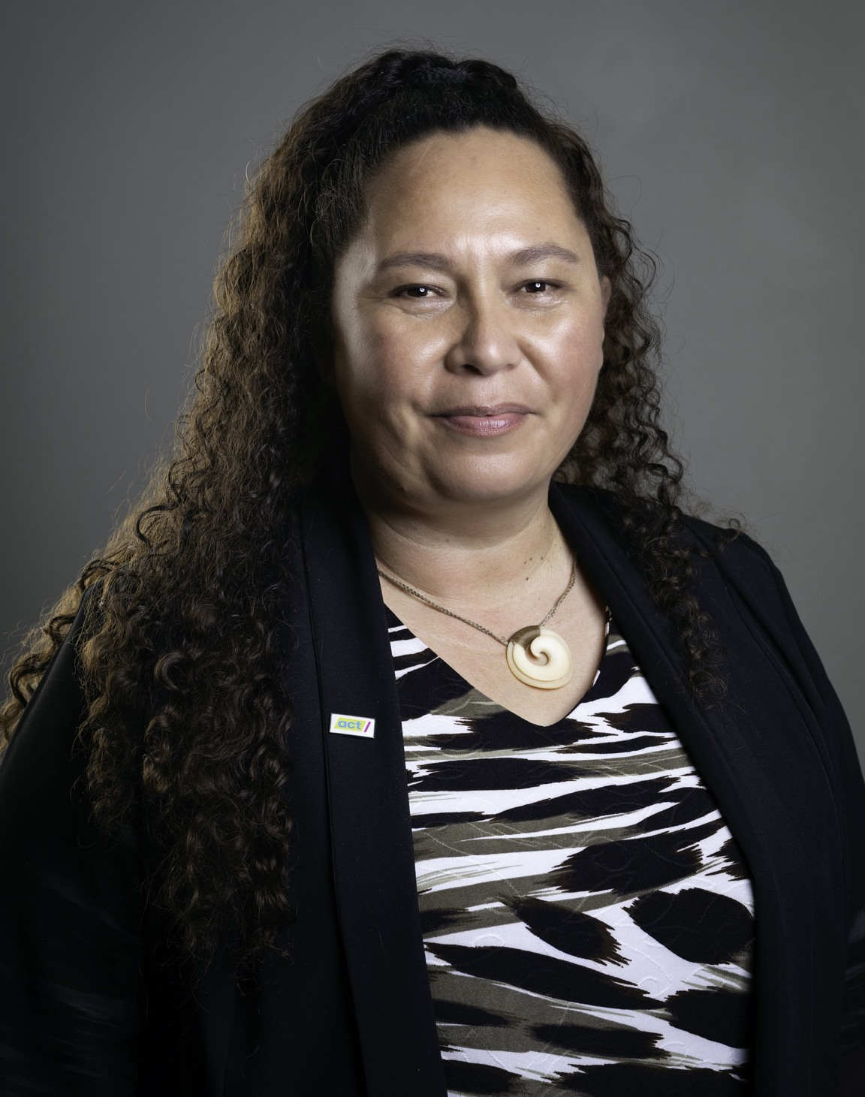
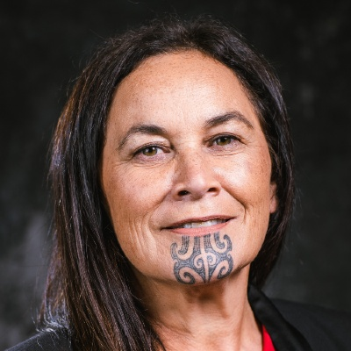
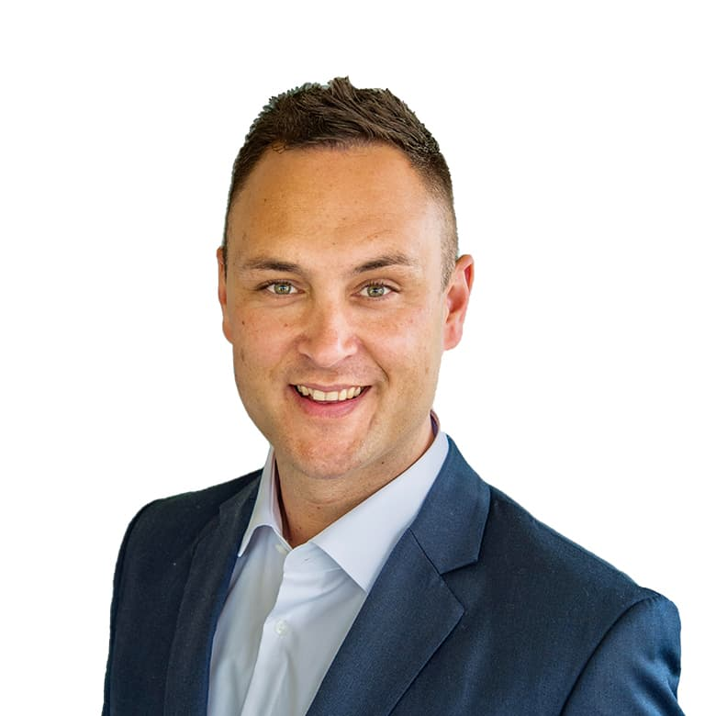
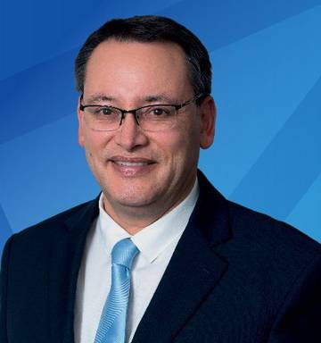
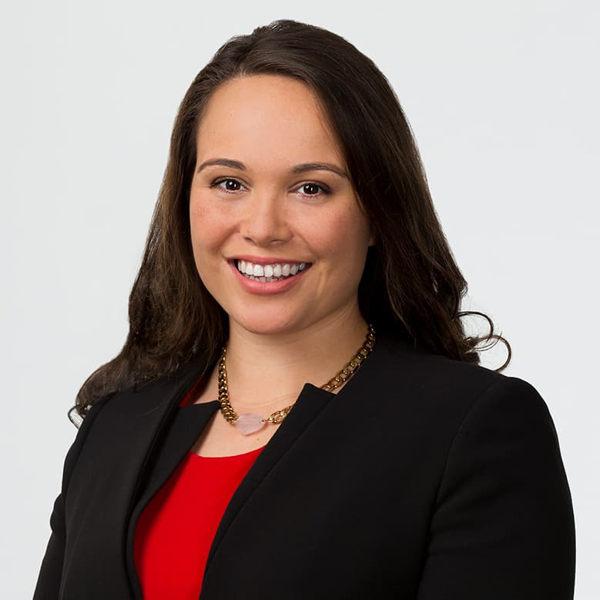
Māori representation in Parliament
Labour will have a caucus of 15 Māori MPs after the 2020 election, National can boast just two of Māori descent, Act and the Greens will also have two MPs of Māori descent and the Māori Party will have two MP’s.
Notes:
As of 19 October 2020

Slide 42
Ministers of the Crown focused on Māori and Treaty Relationships
Hon Andrew Little – Minister of Health and Ministry of Treaty of Waitangi Negotiations.
Hon Kelvin Davis – Minister for Māori Crown Relations: Te Arawhiti, Minister for Children, Minister of Corrections, and Associate Minister of Education (Māori Education).
Hon Nanaia Mahuta – Minister of Foreign Affairs, Minister of Local Government, and Associate Minister of Māori Development.
Hon Peeni Henare – Minister of Defence, Minister for Whānau Ora, Associate Minister of Health (Māori Health), Associate Minister of Housing (Māori Housing), and Associate Minister of Tourism.
Hon Willie Jackson – Minister for Māori Development, Associate Minister for ACC, and Associate Minister of Justice.
Kiri Allan – Minister of Conservation, Minister for Emergency Management, Associate Minister for Arts, Culture and Heritage, and Associate Minister for the Environment.
Hon Meka Whaitiri (Minister outside of Cabinet) – Minister of Customs, Minister for Veterans, Associate Minister of Agriculture (Animal Welfare), and Associate Minister of Statistics.

Slide 43
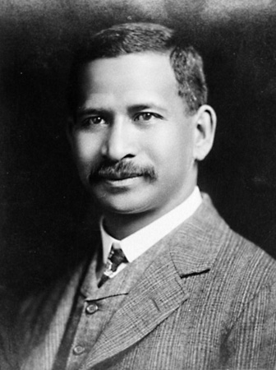
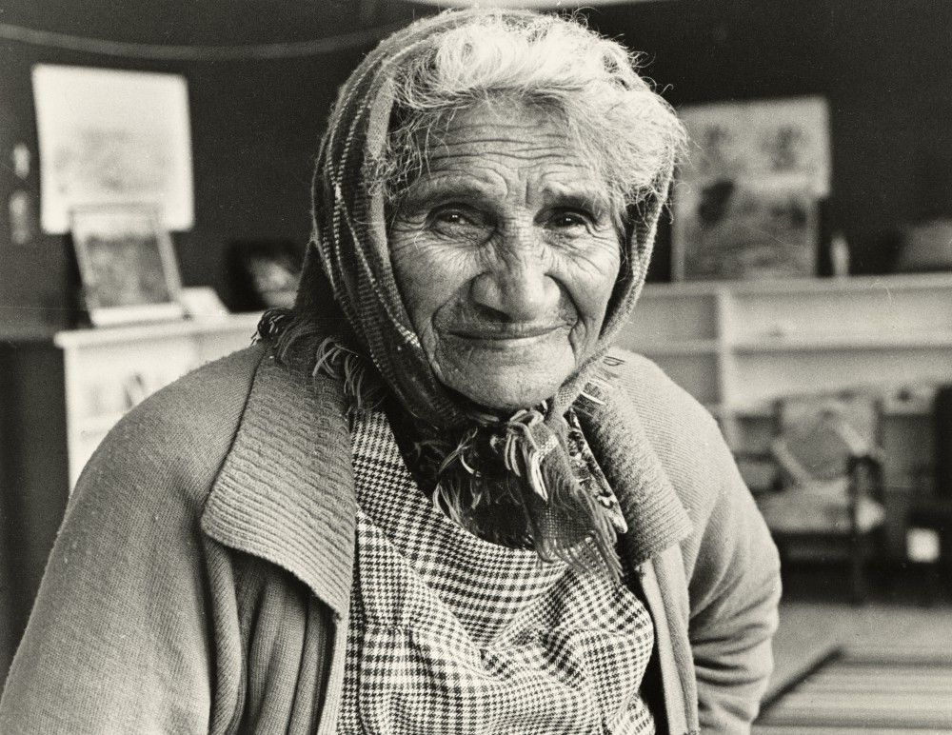
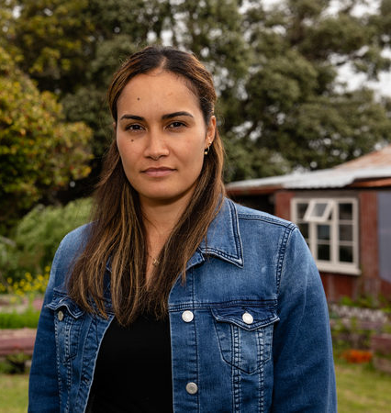
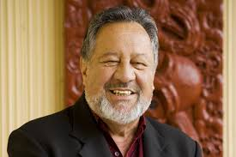
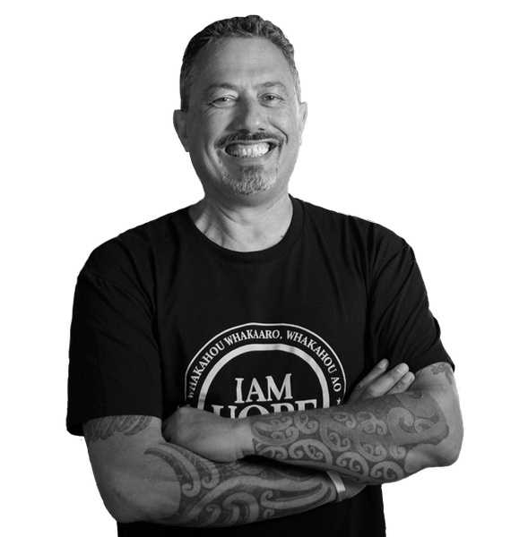
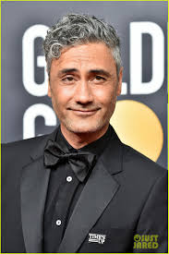
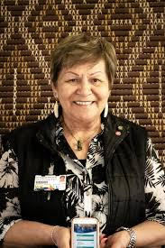
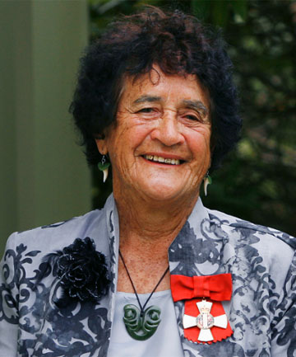
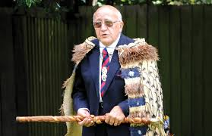
Māori leadership – other sectors

Slide 44
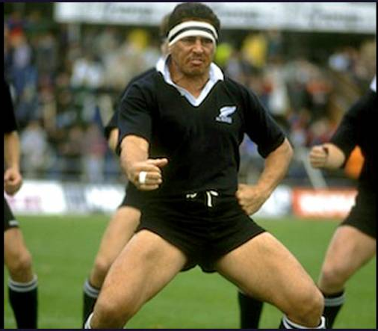
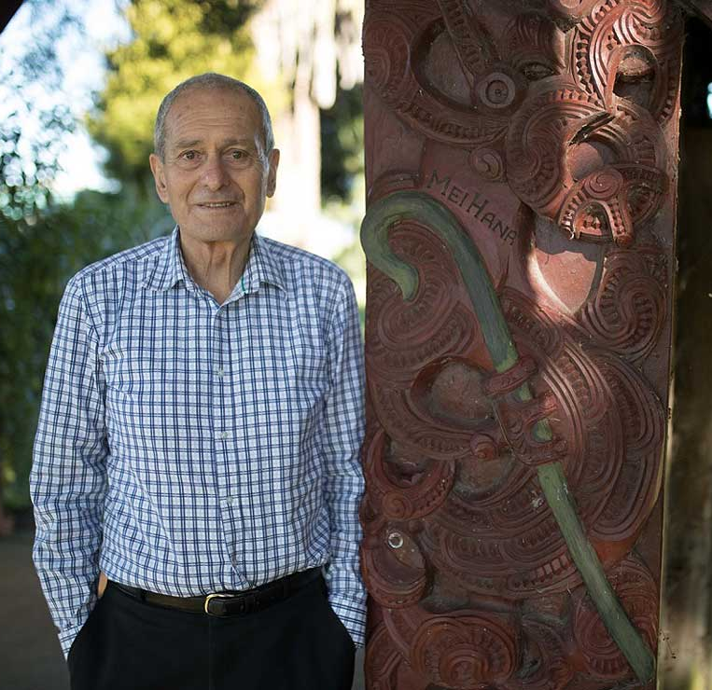
Māori leadership – other sectors

Slide 45
What does this all mean for us?

Slide 46
Incorporating Treaty values into organisational values
Te Poukapa Māori Mo Ngā Tauritetanga a Tangata PHO Treaty Equity Matrix |  | Te Tiriti o Waitangi
 |  | Article 1 | Article 2 | Article 3
 |  | Kāwanatanga/ Governance | Rangatiratanga/ Agency | Oritetanga/ Equity
PHO Values | Collaboration Kotahitanga | The PHO will actively demonstrate Treaty of Waitangi principles. | The PHO supports Māori led agency at a local, regional and national level. | The PHO will prioritise achieving Māori Health Outcomes.
 | Accountability Whakapono | Māori have valued representation in governance and advisory roles in the PHO. | The PHO will collate and distribute intellectual property to support Māori agency. | The PHO values the view offered by equity and Whānau Voice.
 | Respectful Aroha | The PHO recognise the status of MOU based relationships with Treaty of Waitangi Partners. | The PHO values relationships with Māori practices, Whānau Ora partners, Marae and community groups. | The PHO embraces cultural integrity of Māori Kawa and Tikanga.
 | Excellence Hiranga | The PHO will set the standard nationally for Māori governance in primary care. | The PHO aspires to grow Māori owned practices in Tāmaki Makau Rau. | The PHO is committed to attracting and retaining Māori expertise at all levels of the organisation.

Slide 47
Building positive Treaty relationships

Slide 48
Building positive Treaty relationships

Slide 49
Building positive Treaty relationships

Slide 50
Implement cultural frameworks across the primary health care networks
Wāhanga | Kaupapa Kōrero | Content | Description
Ko Wai Au | Reflection of oneself as a culture bearer - Aromatawai | Aromatawai Process of self reflection. Kawa Whakaruruhau Cultural Safety | Reflective self-assessment and acknowledging of self and other cultures - Identify, model of practice and practice principles as platform for creating space to learn about others
Te Ao Mārama | Ka Puta Ki Te Whai Ao Ki Te Ao Marama | Te Kore, Te Po, Te Ao Marama | Explore the genesis of the Māori world view and how Māori connect to the environment, to phenomena and to each other. Key Concepts: Te Kore, Te Po, Te Ao Mārama
 | Genesis
 | Ko Te Ao Māori | Tapu, Noa, Mana, Mauri, Ora, Kawa, Tikanga, Whakaritenga | Familiarisation with the origins and purposes of customs and protocols that inform a Māori way of life. Key concepts: Tapu, Noa, Mana, Mauri, Kawa, Tikanga, Ora, Whakaritenga, Whakawātea
 | Structures, Customs and Protocols of the Māori World (Pre-Contact)
Te Ao Hurihuri | Te Whakaputanga o Niu Tireni me Te Tiriti o Waitangi | Response to colonisation, assimilation and policy of the Crown | Understand the purpose and intent of the Declaration of Independence 1835 and the Treaty of Waitangi 1840 for Māori. Key Concepts: Mana Motuhake, Tinorangatiratanga, Whānau, Hapū, Iwi
 | Māori Soveriegnty and Self-Determination
 | Hauora Māori | Whānau Ora, Oranga, Pae Ora, Hauora, Toi Ora | What does ora mean to Māori and how do the many frameworks and strategies in health relate to oranga? Key concepts: Whānau Ora, Oranga, Pae Ora, Hauora, Toi Ora
 | Māori Wellbeing Frameworks
 | Te Mana Motuhake | The Māori response to issues perpetuated by policy and practice. | What does self-detemination mean to Māori and what does that look like? Key Concepts: By Māori, with Māori for Māori
 | By Māori, to Māori, for Māori
 | Ko Ngā Ringa-raupa me Ngā Ringa-rehe | Kaiārahi Māori in the community | Who are the champions in the community that whānau turn to in their time of need? Key concepts: He kai kei ūku ringa
 | The Māori Community Practitioner
Te Tumu Waiora | Te Tumu Waiora | Whānau Ora, Oranga, Pae Ora, Hauora, Toi Ora | Why should whānau engage with TTW and what do they get here that they don't get anywhere else? Key concepts Wai Ora, Toi Ora, Oranga, Whānau Ora
 | Te Tumu Waiora Service Principles
 | Te Ara Poutama | What I bring to Te Tumu Waiora as a practitioner | What do I bring to TTW and what do I need to be part of the TTW kaupapa? Key concepts: Tāku mahi, Tāku Poipoia
 | My Journey as a Practitioner
 | Mana Motuhake | Whānau experience is enhanced | How does TTW enable the voice and choice of whānau? Key concepts: Mana Motuhake, Whānau Voice and Whānau Choice
 | Whānau Voice and Whānau Choice

Slide 51
Have you read the Ministry of Health – Māori Health Action Plan?
https://www.health.govt.nz/publication/whakamaua-maori-health-action-plan-2020-2025
Notes:
https://www.health.govt.nz/publication/whakamaua-maori-health-action-plan-2020-2025

Slide 52
Have you read the Health Care Home Collaborative – Enhancing the Health Care Home Model of Care?
https://www.healthcarehome.org.nz/download/enhanced-hch-moc-october-2020-final.pdf?inline
Notes:
https://www.healthcarehome.org.nz/download/enhanced-hch-moc-october-2020-final.pdf?inline

Slide 53
What does this mean?
Has your organisation captured and analysed the following data for your organisation on Māori Workforce to address equity gaps?
Number of Māori doctors in your network.
Number of Māori nurses in your network.
Number of Māori General Practice staff in your network.
Number of kaupapa Māori General Practices in your network.
Number of Māori on the Board of your organisation.
Number of Māori staff in our organisation.
How many of those Māori staff hold Leadership positions.

Slide 54
What does this mean?
Has your organisation analysed the clinical indicators for Māori versus Non-Māori?
Enrollment vs non-enrollment.
Immunisation rates - Māori vs Non-Māori.
Diabetes rates - Māori vs Non-Māori.
Cardiovascular rates - Māori vs Non-Māori.
Smoking rates / smoking referals to support programmes - Māori vs Non-Māori.
Cancer screening - Māori vs Non-Māori.
Mental health referals - Māori vs Non-Māori.

Slide 55
What does this mean?
Māori represent 15% of the total population of Aotearoa.
Māori represent between 20% - 30% of most negative health indicators.
The Treaty of Waitangi says that everything needs to be done in partnership with Māori, a partnership is 50-50.
Does your organisation reflect this?
Do your organisational policies reflect the Treaty principles?

Slide 56
He aha te mea nui o te ao
What is the most important thing in the world?
He tangata, he tangata, he tangata
It is the people, it is the people, it is the people”
Whakataukī (Māori proverb)

