Slide 1
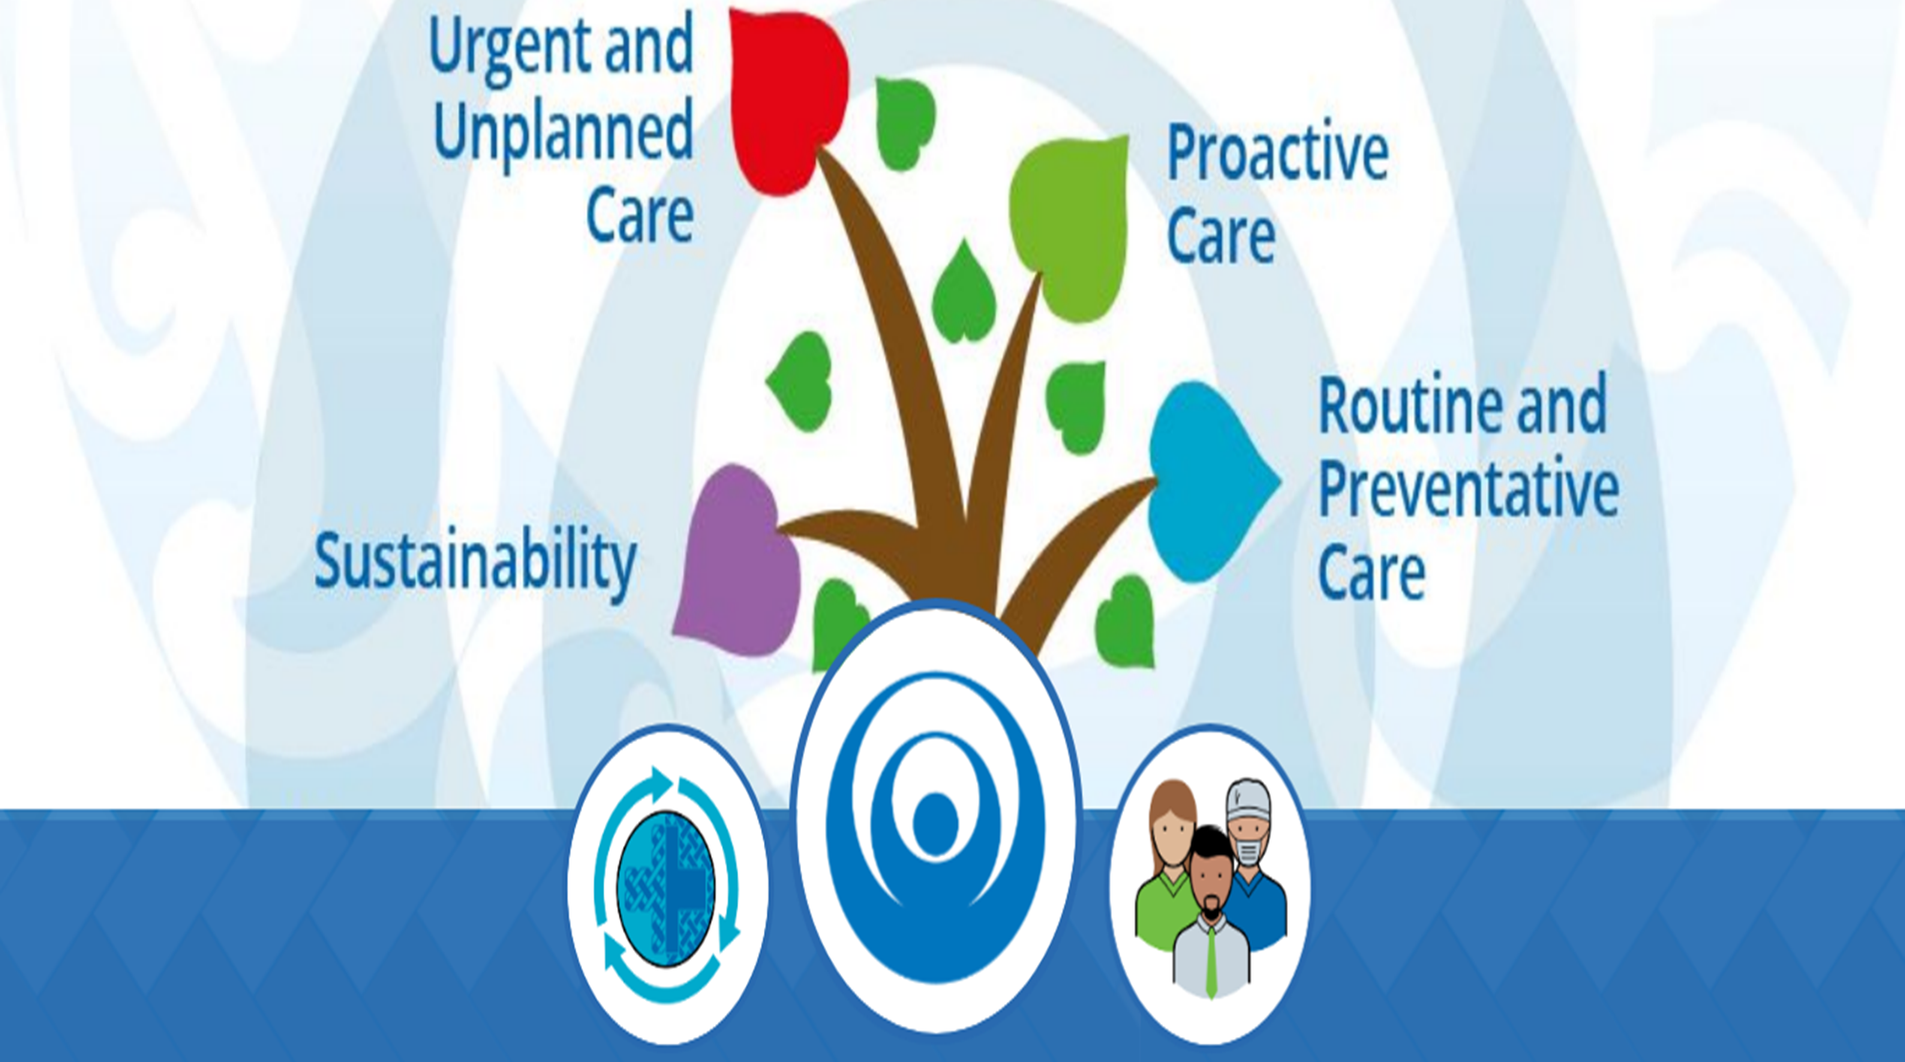
Health Care Home Huddles and Visual Management
Nov 2020

Slide 2
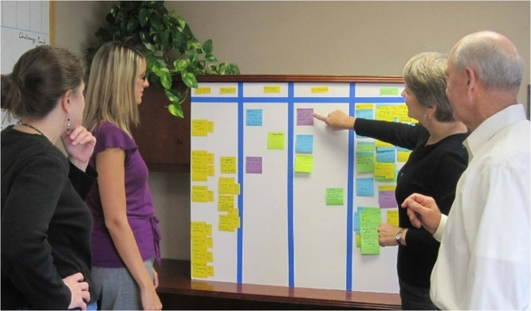
What are Huddles
Huddles involve the practice team meeting daily at
set times to discuss a limited range of topics.
They are short focused meetings where issues and concerns can be raised and dispatched.
They are efficient means of smoothing out the pressures that general practices face on a daily basis, without leaving individuals to battle out difficult situations on
their own.

Slide 3
How to set up huddles
Structured agenda
Short team based stand up Meeting
PROACTIVELY IDENTIFY UNDERSTAND AND DEAL WITH DAILY WORKFLOW
Time limited 5-7mins
CENTRAL LOCATION – VISUAL BOARD
Notes:
Smaller general practice teams and larger teams

Slide 4
Agenda Items – tips and tricks
Prior to the Huddle
PCPA prints out the templates and
marks outstanding items
Update the team board
During the Huddle
Staff achievement and recognition
Review templates for:
Acute demand capacity / triage
Bottle necks – lengthy appts, minor surgery, chaperone requirements
Staff movements – leave, room allocation, training

Slide 5
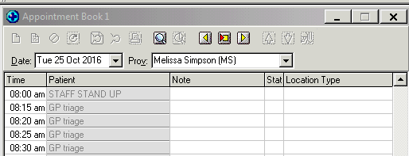
Agenda Items
Outstanding clinical items – overdue recalls,
Check and discuss the indicators which are at risk/red on the patient dashboard?
Check for openings that can be filled, or identify appointments booked for chronic no-shows.
Any special instructions for the PCPA or triage nurse?
Quality targets for the week ahead
Continuous improvement update – policies
Notes:
Helps to plan for full staff meetings or smaller clinical team meetings – report back

Slide 6
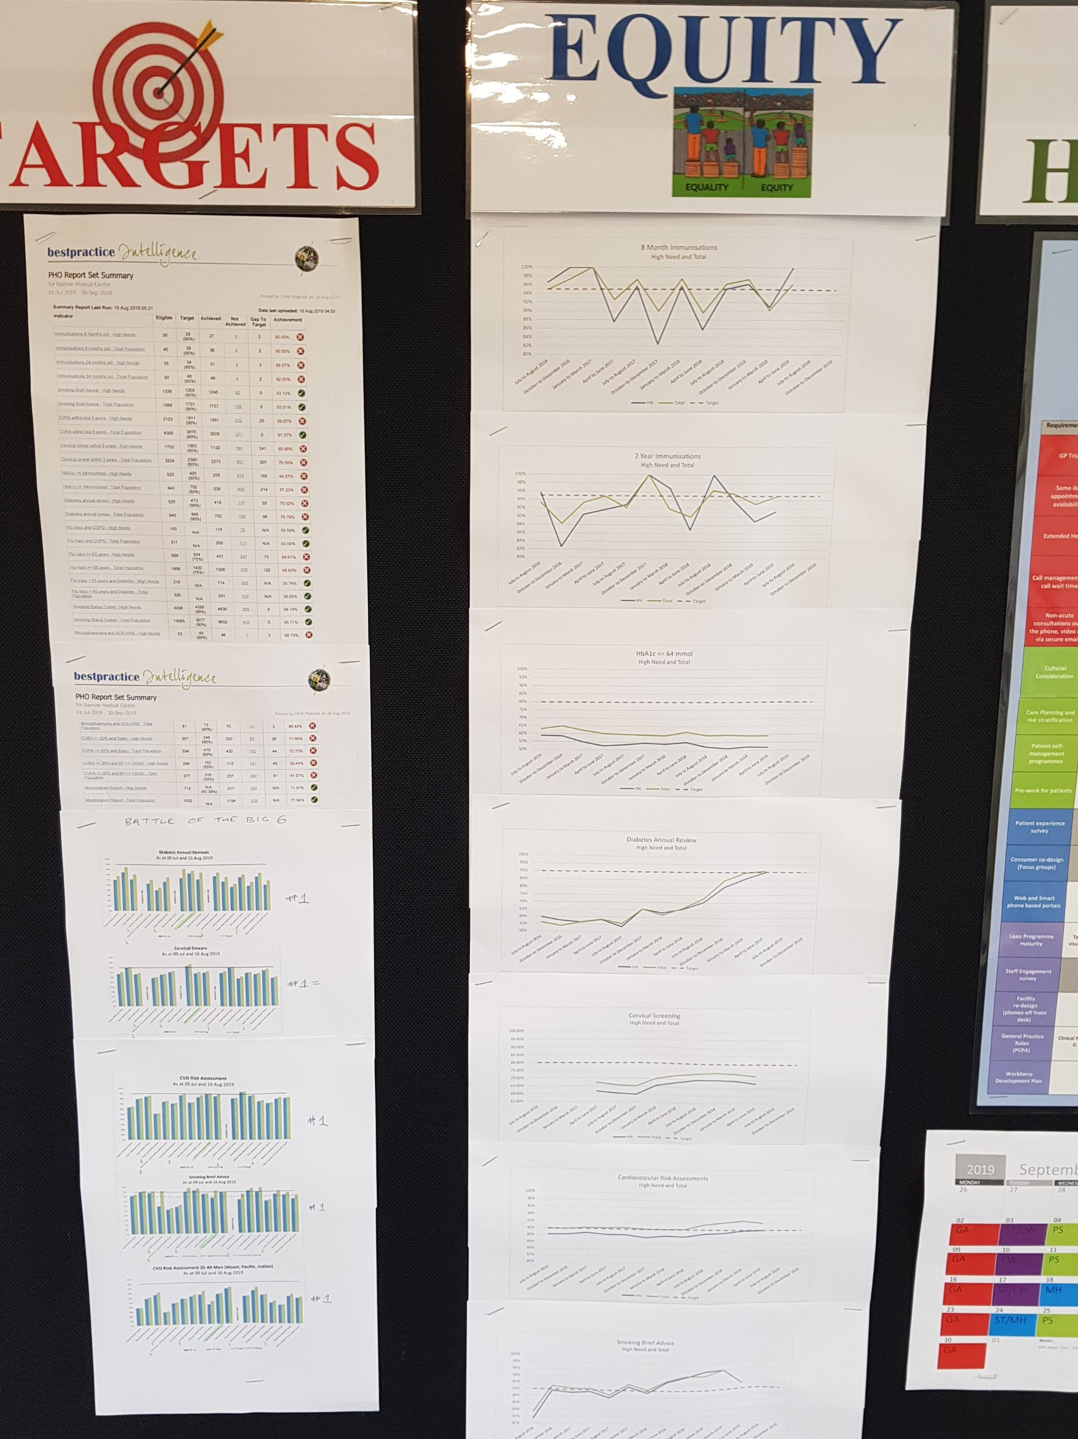

Slide 7
Critical Success Factors for HCH
Change Management
Clinical leadership
Coordination & Collaboration
Continuous quality improvement – PDCA
Access to knowledge & support
Notes:
- What is your role in the change? leading change, adaptiveness, sphere of influence

