Slide 1

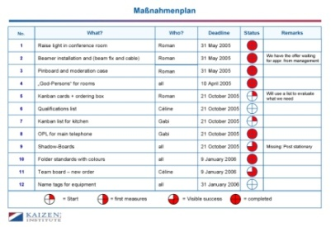
Standard Agenda
1.
2.
3.
4.
Fixed Meeting time:
People
Performance
Continuous Improvement
Roles & Responsibilities matrix
New improvement ideas
Skill/Competency & training needs
How are we doing today?
What does a good day/ week look like?
Just do it
Problem Solving
Completed
Daily KPI’s (Targets vs. Actual)
1. Perf Reviews completed
1. Perf Reviews completed
2. Payroll re-openings
Rosters, planners
Register of completed ideas
Problem Solving Working Docs
Action plan
What | Who | When | New Std?
define the
problem
root cause
verify
PLAN
solutions

