Slide 1
An Apprenticeship in Health and Wellbeing Wellsouth
The New Zealand Certificate in Health and Wellbeing
(level 4)
Primary Care Practice Assistant

Slide 2
Gender of apprentices

Slide 3
Age spread of apprentices

Slide 4
Ethnicity spread of apprentices

Slide 5
Number of apprentices by region

Slide 6
Number of apprentices by sector

Slide 7
Turaukawa Bartlett – Whānau Support Worker
“This training has equipped me with the essential skills to ensure all whānau receive the best care possible whilst empowering them to make positive changes in their lives.”

Slide 8
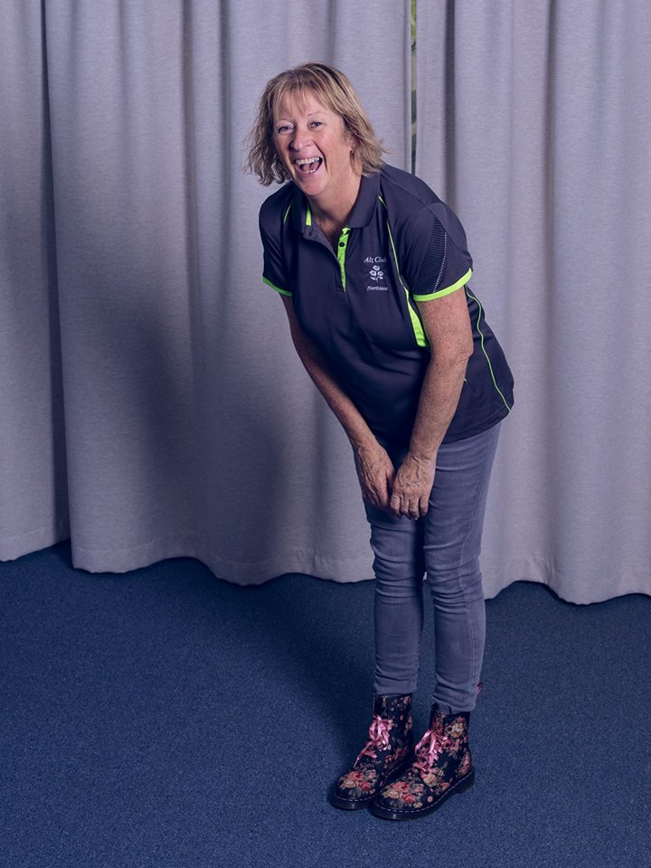
Pauline Plewinski – Diversional Therapist
“Although my background is in aged care and dementia care, through studying the Diversional Therapy Apprenticeship I am gaining a much deeper understanding of how the games and activities we run every day at work helps our clients.”

Slide 9
Deb Morrison – Primary Care Practice Assistant
“I do things totally different now because I have a better understanding now why I’m doing it and I’m thirsting for more knowledge now as to why I’m doing it.”

Slide 10
Nicola Mason – Social Service Worker
“I am listening to people’s stories or issues that they may be having and I am able to look at it in a more holistic way. So, this study is helping validate the way I work intuitively anyway.”

Slide 11
How does it work ?
An apprenticeship advisor will work with you to
Create a training plan
Discuss a training needs analysis
Walk through the programme modules
Discuss the TEC code of good practice
Ensure the apprentice is aware of the next steps

Slide 12
What support will I get
Employers will receive regular updates on progress
Observations in the workplace are REAL and are a component of the programme
Regular visits to the workplace by the apprenticeship advisor
Pastoral care
Assessment online , verbal and observed
Coaching and support for literacy or other

Slide 13
Contact us:
Apprentice Advisor: Sarah Orr
Email: sarah.orr@careerforce.org.nz
Phone: 021 294 9389
https://www.careerforce.org.nz/apprenticeships/

