Slide 1
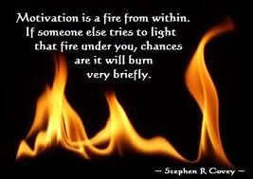
Motivational Interviewing
Partnership-Acceptance-Compassion-Evocation
Engage-Focus-Evoke-Plan

Slide 2
By the end of this workshop you should be able to;
Define MI spirit and process
Describe core MI skills
Demonstrate MI skills
Explore and develop change talk

Slide 3
MI might be easy to learn if:
you are client centered
you honour the wisdom and resources that are already within people
you are a good listener
you expect and accept that people may be in two minds about changing a behaviour
you value autonomy
two of the core attitudes you model are empowerment and humility
you are open to working in a different way.

Slide 4
Think of something that you are thinking about changing but have not gotten around to…

Slide 5
Steps to Change
Ask the person what they are thinking about changing and then…
Tell them why they should make this change
Tell them three specific benefits that would result from making the change
Tell them how they could make the change
Try and persuade them to do it
14

Slide 6
There is something in human nature that resists being coerced and told what to do.
Ironically, it is acknowledging their freedom to choose and not change that sometimes makes change possible.

Slide 7
Four Common Ideas
Insight Induction
if you can make people see, then they will change.
Knowledge Induction
if people know enough, then they will change.
Skill Induction
if you teach people how to change, then they will do it
Distress Induction
if you can make people feel bad or afraid enough, they will change
11
Notes:
Show them the light by giving insight
Give them books, pamphlets, lecture and infomercials
Give them the tools and teach them how to use them
Give them Hell

Slide 8
The Righting Reflex
“A natural and instinctive response of trained care providers is to fix the problem…” Miller & Rollnick

Slide 9
The alternative to trying “to fix it”
“One thing that we know very clearly is that if you cause people to argue for a particular position on a consequential issue, one that matters to them, without any obvious coercion or heavy handed influence, they are likely to move in that direction” Miller 2012

Slide 10
MI is a collaborative, goal-oriented style of communication with particular attention to the language of change. It is designed to strengthen personal motivation for and commitment to a specific goal by eliciting and exploring the person’s own reasons for change within an atmosphere of acceptance and compassion

Slide 11
Partnership
Acceptance
The Spirit of MI
Compassion
Evocation

Slide 12
MI Processes
Engaging-whakawhanaunga
Can we work together?
Focusing-whakamārama
what is the change issue?
Evoking-whakapuāwai
what is your patient saying about change?
Planning-whakamaheretia
how is this change going to be implemented?
The confluence of these four processes describe MI

Slide 13
Partnership
Acceptance
Plan
Evoke
Focus
Engage
The Process of MI
Compassion
Evocation

Slide 14
Partnership
Acceptance
Plan
OARS
Evoke
Focus
Engage
The Process of MI
Compassion
Evocation

Slide 15
The skill of Information exchange
Ask the person what they already know
(about changing the behaviour)
Ask permission to add information
Provide information about what you know …
Ask the person their thoughts about the information provided
Notes:
Use this when you need to inform, educate or provide feedback

Slide 16
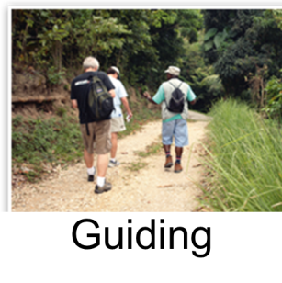
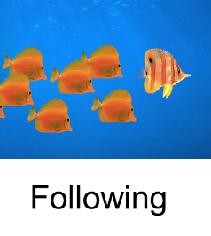

Slide 17
A good guide will:
Ask where the person wants to go and get to know him or her
Inform the person about options and see what makes sense to them
Listen to and respect what the person wants to do and offer help accordingly

Slide 18
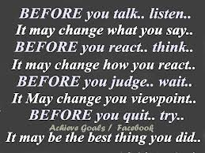
OARS skills Open questions Affirmations Reflections Summaries

Slide 19
Open Questions
“How can I help you?”
“tell me about ___?”
“How would you like things to be different?”
“What are the positive things and what are the less good things about ___?”
“What will you lose if you give up ___?”
“What have you tried before?”
“What do you want to do next?”
Notes:
Can’t be answered yes or no.
Avoid asking “why?” (leads to rationalization, justification)
What have you considered doing different?
How would you like thing to be different?
What does drinking do for you?
When would you be most likely to share needles with others?

Slide 20
Affirmations
Statements of recognition of client strengths.
Build confidence in ability to change.
Must be congruent and genuine.
Notes:
Be as specific as possible “You really kept your cool
when that guy started yelling at you. That’s show’s a lot of self-control”
“I’ve noticed over the past few weeks how you’ve taking much better care of your hygiene …
“When you relapsed last week, you really got back on track quickly …”

Slide 21
Reflections
“Reflective listening is the key to this kind of work.
The best motivational advice we can give
is to listen carefully to your clients.
They will tell you what has worked and
what hasn’t. What moved them forward and
shifted them backward. Whenever you are
in doubt about what to do, listen.”
- Miller & Rollnick, 1991

Slide 22
Active Listening
Patient:
What I say
Practitioner:
What I hear
What I mean or feel
What I understand

Slide 23
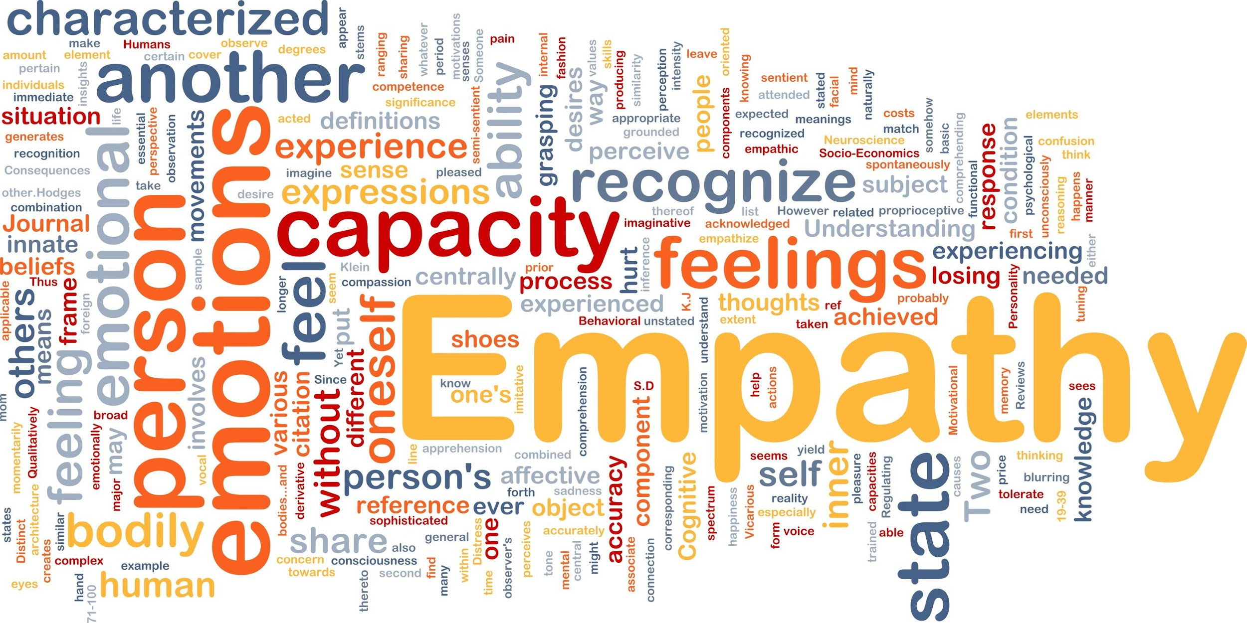

Slide 24
The quality of a practitioner's empathy is a strong therapeutic element

Slide 25
”Empathy and understanding must precede advice”

Slide 26
Level of Reflections
1. SIMPLE
Repeating, rephrasing; staying close to the content
2. AMPLIFIED
Paraphrasing, double-sided reflection; testing the meaning/what’s going on below the surface
3. FEELINGS
Emphasizing the emotional aspect of communication; deepest form

Slide 27
Levels of reflection
Simple Reflection – stays close
Repetition
Rephrase
Complex Reflection – makes a guess, adds meaning
Paraphrase, continuing the paragraph
Reflection of feeling, metaphor etc
Double sided reflection - both sides of ambivalence

Slide 28
“I want to do my exercises but
I’m not getting better.”
“I know I should take my medications but I am fed up with the side effects”
“I could try and lose some weight, but it’s hard to do in my situation”

Slide 29
SUMMARIZING “Let me see if I understand thus far …”
Form of reflective listening.
Ensures clear communication.
Use at transitions in conversation.
Be concise.
Reflect ambivalence .
Accentuate “change talk.”
Notes:
Summarizing is a particular kind of reflective listening -- used at transition points in conversation
“Let me see if I understand so far …”
“Here is what I’ve heard. Tell me if I’ve missed anything … anything you want to add”
Give attention to “change statements” e.g. problem recognition, statements of concern, intent to change, optimism
Providing Choices
Ask what ideas they have about addressing problem
Brainstorm all options - not just the things you think are right
Ask permission to suggest options/choices

Slide 30
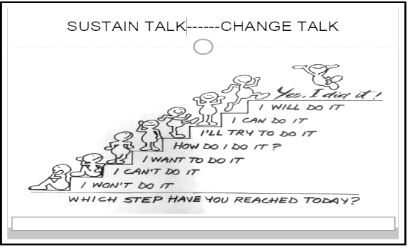
Sustain talk - change talk

Slide 31
Steps to Change
Ask the person what they are thinking about changing and then…
Ask why the person should make this change
Ask for three specific benefits that would result from making the change
Ask how they could make the change
Summarise what you have heard
What are the next steps
14

Slide 32
CAN MI HELP YOU IN YOUR WORK?
The evidence tells us it works
MI can help with conversations about change
It helps people work through difficult decisions
Change talk predicts behaviour
Empathic listening leads to better satisfaction
People who use MI feel more satisfied in their work
MI helps you be a better guide

