Slide 1
Community Health Networks
22 July 2020
Chris Fawcett
Mabli Jones

Slide 2
Aim of the session
Check that we are on the right track
Give some practical examples on how Networks could work and what they might do
Show some interesting data
Look at how the funding might flow
Think through the local governance of a Network Board
Share the proposed approach for the roll- out of funded quality peer groups as part of this process
Agree timing, next steps and consulting wider with our community/NGO/hospital colleagues

Slide 3
What does a Community Health Network in Kāpiti look like?
The Kāpiti CHN is in the early stages of design, but is likely to include:
Local Governance, to identify and agree shared goals for the Network, and monitor the Network’s progress towards achieving them
Local Leadership, to drive relationships and. services to work in new ways – including both operational and clinical leadership.
Relationships described through Memorandum of Understandings that define the commitment of providers/services to the Network.
Community Engagement – in identifying opportunities and developing solutions.

Slide 4
Principles underpinning a Community Health Network in Kāpiti
Equity will be at the core of CHN development, delivery and decision making Partnership - with iwi, with the community, with Tū Ora Compass Health and with local health and social services.
The principles outlined in the CCDHB Health System Plan 2030 will also underpin CHNs
Kāpiti CHN development and implementation work will be completed in partnership with iwi and Māori providers. Marae and community-based health facilities are crucial in achieving equity (Health System Plan 2030).

Slide 5
Health System Plan 2030
Notes:
Background
CHNs are key to achieving the vision outlined in CCDHB’s Health System Plan 2030. The plan describes CHNs as the ‘central organising point for delivering efficient and effective health care’. The Community Health Network Framework (2018), described eight networks across CCDHB, each with populations of people enrolled in GP practices within a geographical area of between 20-50,000 people.
A key theme of the recent Health and Disability System Review (March 2020) was ‘ensuring consumers, whānau and communities were at the heart of the system’. The below figure is taken from page 70 of the Review:

Slide 6
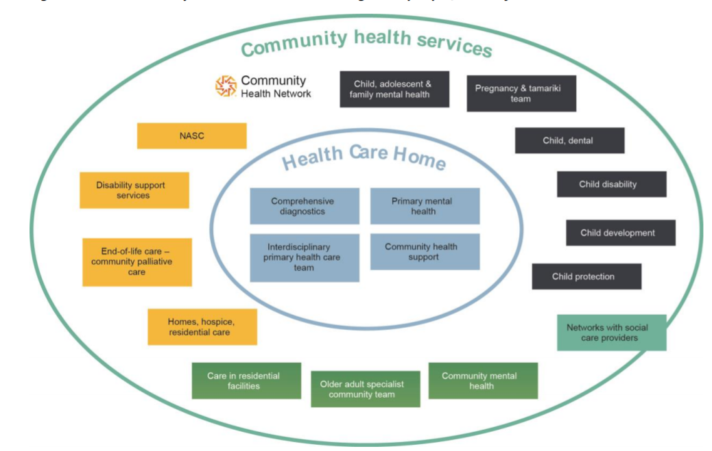
Community Health Networks organise delivery of a broad range of health services, and link to social service providers

Slide 7
Prototype… what’s right for Kapiti? Korero with iwi, consumers and providers

Slide 8
Community Healthcare Networks will…..
Have primary and community-based services at the core
Be the central organising point for the delivery of effective and efficient health and social services for a defined population
Develop bespoke local services, based on demographic and utilisation data and community input including iwi
Aim to reduce inequities and improve outcomes in communities'

Slide 9
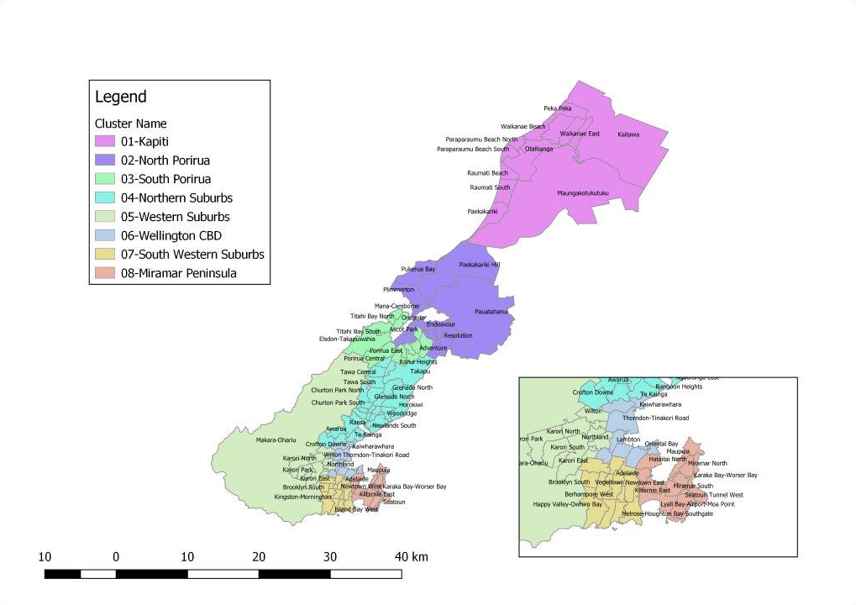
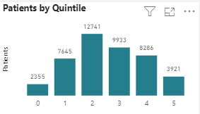
Network Groupings
Kāpiti: 45,000
8 Networks
20 -50,000 people
Based on:
Geography
Pop demographics
Hospital utilisation rates
Primary care enrolment
Communities of interest

Slide 10
What we know
Of those enrolled at a Kāpiti CHN practice, 12% are Māori and 2% are Pacific.
There is also a large and growing proportion of older people in Kāpiti (27% aged over 65) and a large number of Aged Residential Care facilities in Kāpiti.
The Kāpiti Health Advisory Group has identified health of older people as a priority.
Travelling for health care is consistently raised as a major problem for people in Kāpiti.
In 2019 the Urgent and After Hours Kāpiti Project was established to develop delivery models that would support acute (and after hours) services to be delivered closer to home.
An outcome of this project was the initiation of the Kāpiti Community Acute Response Service (CARS). CARS enables people to be transferred by ambulance to their GP or the after hours GP instead of to ED in Wellington, when this is clinically appropriate.
Since CARS began in June 2019, 278 patients have received diversion to a local GP or after hours. Other priorities highlighted through this project included; a comprehensive service directory for providers and community and service developments to support the delivery of more healthcare at home

Slide 11
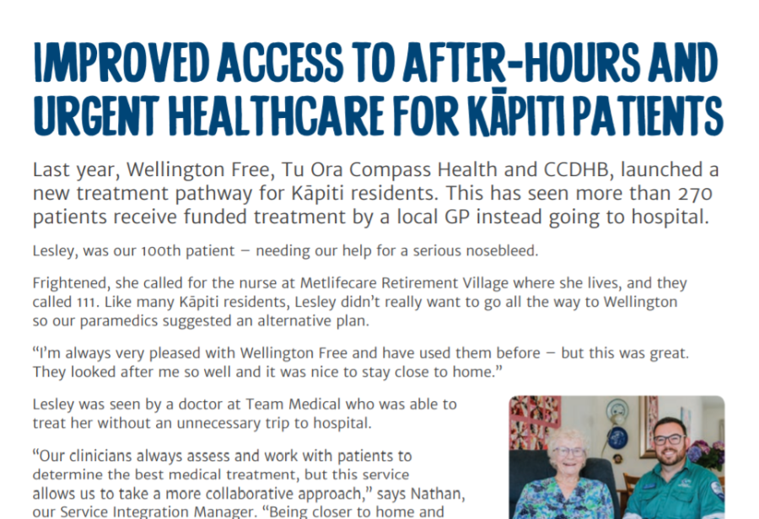
Notes:
Travelling for health care is consistently raised as a major problem for people in Kāpiti. In 2018 the Urgent and After Hours Kāpiti Project was established to develop delivery models that would support acute (and after hours) services to be delivered closer to home. An outcome of this project was the initiation of the Kāpiti Community Acute Response Service (CARS). CARS enables people to be transferred by ambulance to their GP or the after hours GP instead of to ED in Wellington, when this is clinically appropriate. Since it began in June 2019, 278 patients have received diversion to a local GP or after hours. Other priorities highlighted through this project included; a comprehensive service directory for providers and community and service developments to support the delivery of more healthcare at home

Slide 12
Focus on Kāpiti
Notes:
Kāpiti People and Health Landscape
Around 54,000 people call the Kāpiti Coast District Home, including the Ōtaki community which is not within CCDHB district. The three iwi in the Kāpiti Coast District are; Ngāti Raukawa ki te Tonga, Te Āti Awa ki Whakarongotai and Ngāti Toa Rangatira.
Within the Kāpiti CHN area there are 10 primary care practices. The Healthcare Homes (HCH) Programme began in 2016 and is embedded in 7 of the 10 practices in Kāpiti CHN. The figure below describes the differences in population view between the enrolled and domiciled populations. The differences between these two views show that both may need to be considered when developing and delivering a Network.
An MoU exists between MidCentral DHB and CCDHB in relation to the provision of health care for residents of the Ōtaki area. Of those enrolled at a Kāpiti CHN practice, 12% are Māori and 2% are Pacific. There is also a large and growing proportion of older people in Kāpiti (27% aged over 65) and a large number of Aged Residential Care facilities in Kāpiti. The Kāpiti Health Advisory Group has identified health of older people as a priority.

Slide 13
Focus on Kāpiti

Slide 14
Based on the data and the reported patient experience- we might want to start with a focus on older people
Frail older people
Reduce polypharmacy
Falls prevention
CHOPI
Support people at home
Home monitoring
Care coordination
Admission avoidance
Better access to specialist care
Virtual outpatients
Shared care appointments
Increased POACs
Early discharge, AWHI
Community Service integration
Notes:
Developing the core components of the Network and the processes to support ways of working will be a key focus in Year 1. Starting with a focus on health of older people, some of the initiatives that the Network may focus on and develop are shown in the figure below. The Network will build on the foundation of Health Care Homes and community and provider engagement work of the Kāpiti Urgent and After Hours Project.
Over time, and as it develops, the Network will focus on other population health priority areas (such as youth, mental Health and disability).

Slide 15
Governance framework…
Network Operations team
Network board
DHB lead
Tū Ora lead
Iwi
Local Authority
Other services
Network manager
GP lead
SMO lead
Care coordination lead
DN team lead
Ora lead
Pop Health Advisor
ARC
Other leads
Performance tracking

Slide 16
Notes:
Collective Impact will be used to develop and implement a Kāpiti CHN. Collective Impact brings people together in a structured way to achieve change. It starts with a common agenda, it establishes shared measurements, fosters mutually reinforcing activities, encourages continuous communication and has a strong support structure dedicated to orchestrating the work of the group.

Slide 17
Key ongoing roles
Network manager
Overall coordination and accountability
Acute care coordinator
Pull patients from hospital, manage virtual ward flow
Population health advisor
Community service leads
Integrate DNs / Ora into network
Clinical leadership and change support
GP lead
Clinical leadership and change support
SMO lead
Influence social determinants, link to NGO services

Slide 18
Establishment Deliverables
Network Charter
Key role PDs
Joint Accountability Framework
Pop health profile
Information sharing agreement
Health & social service directory
Monitoring Dashboard
Engagement & Communications plan
PIDs for virtual ward, polypharmacy
Year 1 budget & operating plan
Board TOR
Set up virtual ward (?) & SOP
Quality improvement MDT group
Notes:
Outline of Proposed Development of Year 1 of the Kāpiti CHN:
Year 1 will be delivered in two phases:
Phase 1 - Development and Establishment (July - September 2020):
Contract and procurement process for key elements of a Kāpiti CHN
Design and Establish local Kāpiti governance and leadership
Consider the membership and terms of a local governance group
Develop a memorandum of understanding to underpin local service providers involvement and commitment to the Network
Establish the performance management and accountability framework for service delivery in Kāpiti
Explore developing and monitoring CHNs from both a domiciled and enrolled population perspective
Establish baseline population measures to monitor impact and benefit realisation over time.
Phase 2 – Implementation (October 2020 – June 2020):
Establish local Kāpiti Leadership
Establish the local Kāpiti Governance
Establish stakeholder engagement processes, and communicate progress to key stakeholders
Agree local priorities, shared Network goals and Kāpiti CHN Outcomes Framework
Develop a dashboard to monitor progress
Begin reporting on Network goals and outcomes framework
Outline of Proposed Development of Year 1 of the Kāpiti CHN:
Year 1 will be delivered in two phases:
Phase 1 - Development and Establishment (July - September 2020):
Contract and procurement process for key elements of a Kāpiti CHN
Design and Establish local Kāpiti governance and leadership
Consider the membership and terms of a local governance group
Develop a memorandum of understanding to underpin local service providers involvement and commitment to the Network
Establish the performance management and accountability framework for service delivery in Kāpiti
Explore developing and monitoring CHNs from both a domiciled and enrolled population perspective
Establish baseline population measures to monitor impact and benefit realisation over time.
Phase 2 – Implementation (October 2020 – June 2020):
Establish local Kāpiti Leadership
Establish the local Kāpiti Governance
Establish stakeholder engagement processes, and communicate progress to key stakeholders
Agree local priorities, shared Network goals and Kāpiti CHN Outcomes Framework
Develop a dashboard to monitor progress
Begin reporting on Network goals and outcomes framework
Outline of Proposed Development of Year 1 of the Kāpiti CHN:
Year 1 will be delivered in two phases:
Phase 1 - Development and Establishment (July - September 2020):
Contract and procurement process for key elements of a Kāpiti CHN
Design and Establish local Kāpiti governance and leadership
Consider the membership and terms of a local governance group
Develop a memorandum of understanding to underpin local service providers involvement and commitment to the Network
Establish the performance management and accountability framework for service delivery in Kāpiti
Explore developing and monitoring CHNs from both a domiciled and enrolled population perspective
Establish baseline population measures to monitor impact and benefit realisation over time.
Phase 2 – Implementation (October 2020 – June 2020):
Establish local Kāpiti Leadership
Establish the local Kāpiti Governance
Establish stakeholder engagement processes, and communicate progress to key stakeholders
Agree local priorities, shared Network goals and Kāpiti CHN Outcomes Framework
Develop a dashboard to monitor progress
Begin reporting on Network goals and outcomes framework

Slide 19
Funding transition plan in concept…

Slide 20
Funded Quality Peer Groups
“Health Professionals will practice rationally if given independent evidence, feedback, the opportunity to discuss with peers and appropriate incentives”
Evidence
Data
Equity
Independent
Peer - led
Teamwork
Patient Whānau
Notes:
Meet 4 x a year
Funded
Trained peer group leaders
MDT or uni discilinary
Topic based
Use established library

Slide 21
Conventional continuing education
Pros:
Tried and true
Up to date
Little preparation required by organisers
Cheap
Presenter often able to field peripheral questions in specialist area
Good for “updates”
Encourages primary/secondary care communication
Cons:
Not always balanced or evidence based
Risk of industry bias
Secondary care perspective predominates
Weighted to new & relatively untested technologies
Tends to be didactic
Often unidisciplinary
Often different audience each time
One presenter, many learners
Limited ability to interact
Little learner ownership
Unlinked to learner utilisation
Little time for learner experience

Slide 22
Outline of Proposed Development of Year 1 of the Kāpiti Community Network.
Phase 1 - Development and Establishment (July - September 2020)
Contract and procurement process for key elements of a Kāpiti CHN
Design and Establish local Kāpiti governance and leadership
Consider the membership and terms of a local governance group
Develop a memorandum of understanding to underpin local service providers involvement and commitment to the Network
Establish the performance management and accountability framework for service delivery in Kāpiti
Explore developing and monitoring CHNs from both a domiciled and enrolled population perspective
Establish baseline population measures to monitor impact and benefit realisation over time.

Slide 23
Outline of Proposed Development of Year 1 of the Kāpiti Community Network.
Phase 2 – Implementation (October 2020 – June 2020)
Establish local Kāpiti Leadership
Establish the local Kāpiti Governance
Establish stakeholder engagement processes, and communicate progress to key stakeholders
Agree local priorities, shared Network goals and Kāpiti CHN Outcomes Framework
Develop a dashboard to monitor progress
Begin reporting on Network goals and outcomes framework

Slide 24
Questions…

