Slide 1
Supporting people with Long Term Conditions and Complex Health Needs
PPC Steering Group, 17th September 2018

Slide 2
Principles of the co-design process
True Partnership – enable the active involvement and participation of people who are impacted by the design of health and care processes and systems. This includes consumers, carers, health workers, families and whaanau
Respect – the expertise of all involved, ensure that all have an equal voice and practice shared ownership
Teamwork – work together on a shared goal, trust the process and learn together
Safety – is paramount for all involved. Maintain an environment which feels safe and brings confidence for everyone
Value – the lived experience of delivering and receiving care
Be True – to the process, the means is as important as the end.

Slide 3
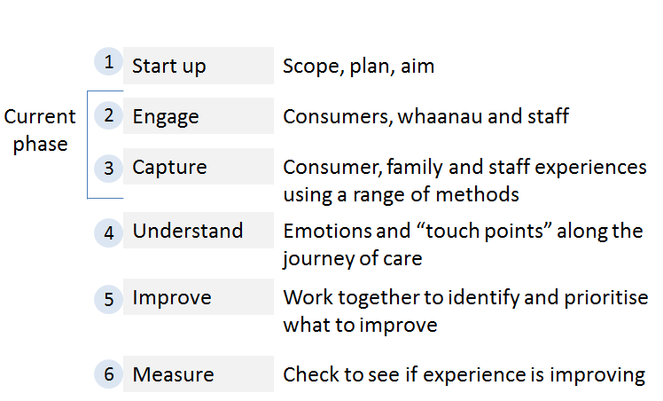
Co-design process

Slide 4
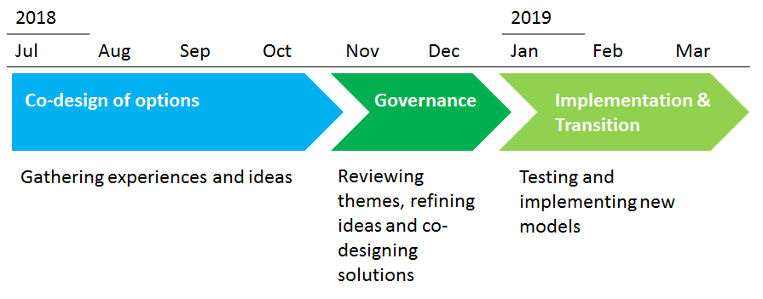
Timeline and proposed process for engagement

Slide 5
What has been working well?:
Team based care
Holistic and patient-centred
Shared cared and team based care including health coaches
Supports continuity
Care planning
“Collaborative process driving self-management support”
Patient-centeredness and an opportunity to problem solve with patient
Care Co-ordination
Clinical and health coach partnership
Warm handovers
Whaanau ora principles (e.g.: coordination and family centred where possible)
Flexibility
Use funding for a variety of purposes, e.g.: transport and medication; home visits by health care assistant to provide outreach service for those not engaging or hard to reach
Allows for innovative model development
Supports addressing social determinants of health

Slide 6
What has not been working so well?:
Administrative burden takes away from time to care for patients
Too many contracts, too many KPIs, too many ‘unhelpful’ assessments, not enough alignment
Lack of clear goals and programme logic
Problems not clearly identified – what are we trying to solve?
Large target population, limited funding
“Goal posts” changing
Outcomes difficult to quantify and accurately measure
Lack of practice level data to direct and support quality improvement
Variation in models of care
Shared Care platform not fit for purpose

Slide 7
What are the opportunities for change?:
Greater focus on patients and whaanau
Funding better aligned to patient need and better targeted
Work with a smaller number of patients/whaanau but more meaningfully
Reduce fee for service, fund for teams and outcome
Providing more services outside of clinical settings and support the social determinants
Increase culturally safe services
Take a wellness and psychosocial approach
Reduce administration
Support innovative models of care
Capture “gold nuggets” of practices who improved their model of care
Build on Enhanced Primary Care model of care changes
Equity-based primary care funding
Engaging with consumers so that they can be confident and able to achieve best health and wellbeing
Build change capability and leadership
Implement health coach/navigator role
Intersectoral assessment, planning and delivery involvement (i.e.: social, justice, education, etc.)
Greater Consumer input
Co-design with population at risk
Measure a range of outcomes

Slide 8
Insights from deep-dive practices about the key components of an effective model of care include:
Flexibility and addressing wellness and the social determinants
Engagement and relationship building
Patient and whaanau based assessment and planning
Team based care
Culturally safe models of care
Coordination and continuity
Accountability

