Slide 1


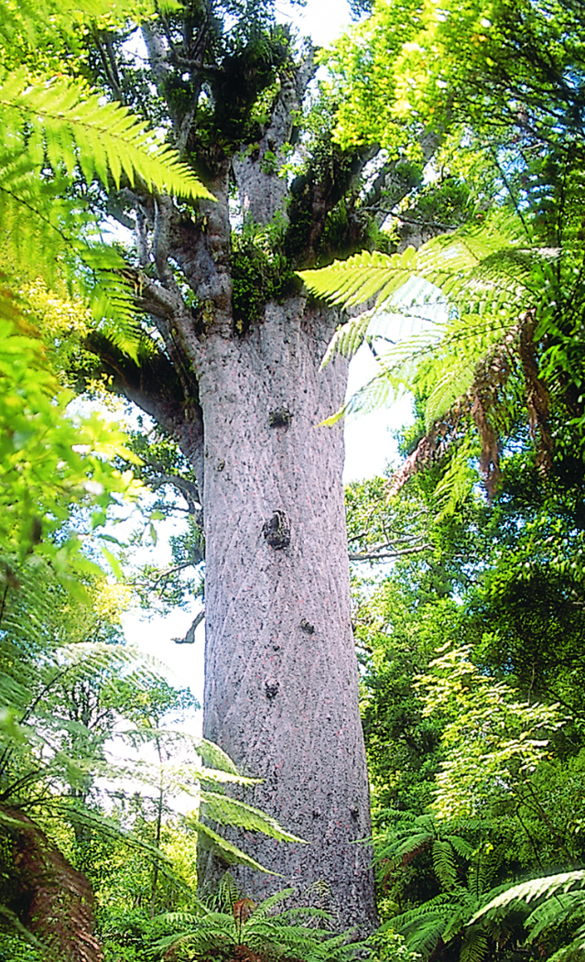

Welcome to beautiful Northland
New Zealand
Hemaima Reihana-Tait
Nurse Director
Mahitahi Hauora
Nov 2020
Prepared for – Primary Health Care / General Practice
Notes:
E kore au , He ngaro , he kakano , he kakano
I rui ruia mai , I rangiatea.
E te atua – to the creator of us all, nga mihi.
To all those who have left a path for us to follow, learn grow and improve, those who are no longer here, but for their struggles, and victories we acknowledge them. We are mindful of all those who have given their time and for some, who gave and lost their lives, tragically through COVID19 we acknowledge you.
Through these times of great medical discoveries and nursing challenge, to Nurses across the world, today who hear my message…..
Nga mihi, e nga mana, e nga reo, e rau Rangatira ma, o nga hau e wha.
I greet , once, twice and greet you once more from Kerikeri, in NZ.
Tena Koutou, Tena Koutou Tena Koutou katoa.
From my ancestors to yours, from my elders to yours, from our wise women and children to yours,,,, we greet you.
Hikurangi te maunga, Taumarere te awa, Waiomio te whenua, Ko Miria te marae.
Ko Kawiti te tupuna,
Ko Kirihi Hare Reihana raua Ko Pikihuia MacDonald toku matua
Ko Ngapuhi, Ngati Hine, Ngati Kahu, Ngati Pihere, Ngati Kere , Ngaitahu, Rangitane oku iwi katoa
Ko Hemaima Reihana-Tait ahau.
My name is Hemaima Reihana-Tait.
Nurse Director in Northland NZ for primary Health Care

Slide 2
Tiheiwa
Mauri ora
Notes:
It is with great pleasure that I bring you a tool kit of principles and practice , presented in a package called the Mauri ora window
This presentation responds to the importance of cultural competency in nursing to address the inequitable health outcomes for indigenous Maori in New Zealand (NZ) through the application of a friendly , easy to apply tool – the Mauri Ora window , to trigger routine best practice engagement skills.
Health equity is defined as differences in health outcomes that are unnecessary , avoidable, unfair and unjust.
A key driver of health inequities is ‘differences in the quality of health care’ which begins at the point of engagement.

Slide 3
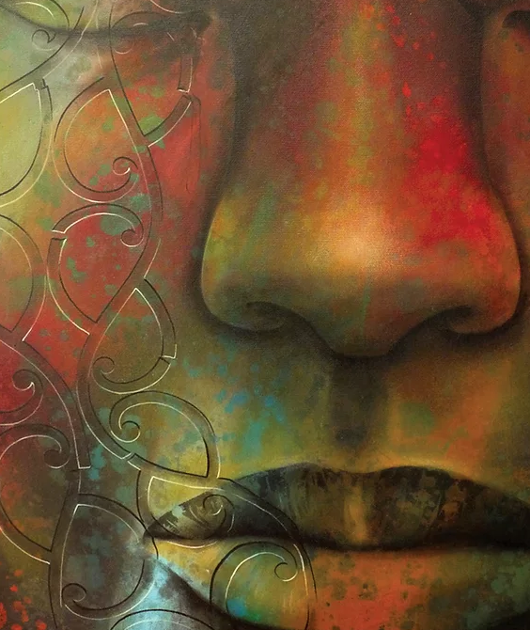
Tiheiwa
Mauri ora
Atua breathed life into man
He sneezed
He became ….
Artwork: Theresa Reihana
Notes:
The ancient ancestral story of mankind, passed on to me, tells of the creation of humans fashioned from the dust of the earth formed and shaped.
Then the creator breathed into the form of humans to which they took in the breath of life, and sneezed …. Tiheiwa Mauri ora….
This is the expression that came from my ancestors , marking the moment that breath came into humans and now from then till present day we greet each other with
Mauri ora – life to you.

Slide 4
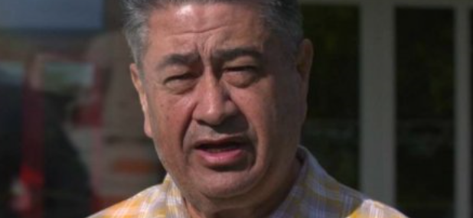
Mauri ora
Tamati Krueger
‘Mauri ora is feeling the thrill of being alive.’
In this place where the rapture of life is full, mauri ora can be restored and sustained. This comes from unconditional acceptance of who they are , others understanding what is important to them and having self efficacy to determine life direction’
Notes:
Tamati Kreuger is a well respected Elder from Tuhoe- a tribe from a central North Island region:
Mauri ora he says is feeling the thrill of being alive.’
In this place where the rapture of life is full, mauri ora can be restored and sustained. This comes from unconditional acceptance of who they are , others understanding what is important to them and having self efficacy to determine life direction’
Consider a time when you felt life breathed into you from :
Your family and friends – perhaps it was your birthday and you just knew that every effort was made to focus on you
Perhaps Your colleagues and employer, other nurses in your team, or services in your network celebrated a significant achievement
Do you recall the elation, the appreciation, perhaps the value of your contribution. Do recall the emotion, the high, the unconditional acceptance from them of who you are?
Did that celebration put wind in your sails, did it carry you a few days, did it make you feel hopeful, valued and more able. Did it empower you, strengthen you and give you permission to try again, expand yourself.

Slide 5
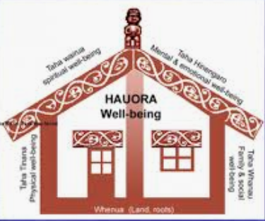
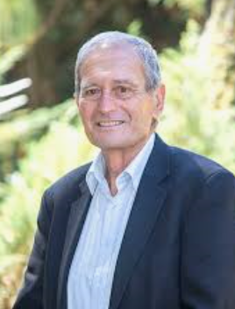
An impoverished family
Mauri ora Flourishing | vs | Mauri noho Languishing
Enlightened spirit | Spiritual | A loss of hope
Clear and alert mind | Mental | A clouded mind
Fit for purpose body | Physical | A tortured body
Nurturing and resilient whanau/ family | Emotional | An impoverished family
Four pillars of wellbeing resembles the structure of a house
Notes:
Sir Mason Durie:
Is an esteemed Maori professor of Massey University. He uses the construct of a four walled house, ‘whare’, as pillars for wellbeing, suggesting that the presence of all four sides of the house need to be present for the strength of the whole whare or house.
Any impact both positive or negative will profoundly affect the standing of the house.
He expresses both the strengths and weaknesses as presented in the table.
Mauri ora – or flourishing where life is breathed into the experience of an individual is expressed
spiritually as an enlightened spirit,
mentally as a clear and alert mind,
physically as a fit for purpose body
emotionally as a nurturing and resilient family – the family or whanau being a fountain of resource bubbling up like a well to sustain the individual and family.
The opposite of ‘Mauri ora’ is ‘Mauri Noho’ or state of languishing where the person experience highlights loss and grief, which when left unresolved, this grief may remain in a state of despair, anguish and languishing.
Oh how I have preferred the experience of Mauri ora, and when I hear the words they spark in me a responsibility to ‘pay it forward if you like” to breath life into others.

Slide 6
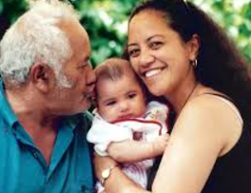
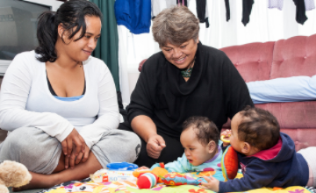
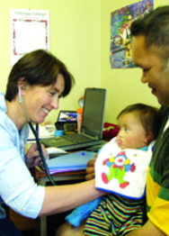
Mauri ora
Breathe life
Notes:
If you could make a difference in a 20min encounter with a patient – that would bring them back to you, build a strong platform of trust, give them the confidence that what matters to them is significantly important to you, and give them the power to make decisions and take responsibility for
As you approach an encounter with a patient, consider your role as a nurse to make the experience buoyant and bright- breathing hope and compassion into their experience.
They present themselves to you with a task, but they are not a task to be completed.
The people who come to you, may cross many rivers of challenge to reach your service.
How you respond and breathe relief into their experience may make all the difference to lifting and sustaining them to survive their brief encounter with you and go much further managing their journey.
Mauri ora is a key concept in Te Ao Maori (the Maori world view) describing a state of flourishing , where one could experience the thrill of being alive. Such a state fortifies the foundation for engagement between a nurse and a patient , fostering trust confidence and subsequent individual investment in wellbeing and self management . It is aspirational to consider what optimism and growth can occur in an atmosphere where the thrill of being alive is cultivated.

Slide 7

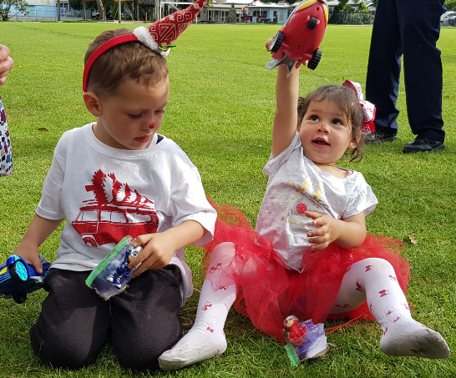
Ka marama ki roto , Ka tiaho ki waho
Hei Kaitiaki , Mauri ora e
What efforts of knowledge and compassion is planted in the heart , these shall be returned to us …. As hope, as breath , as life.
Mauri Ora window

Slide 8
Total enrolled population in Northland : 169057
Total Maori/ Indigenous peoples : 59773 35%
Total non-Maori: 109284 65%
Notes:
The degree to which this discussion is important is found in understanding the demographic of northland acknowledging that the rurality and geography strongly influence the determinants of health for the people of Northland. This maybe the case for you in your practice , or geographical locality as social determinants of health are a root cause of disparity.
It is well known that ‘if you are indigenous , you will be worse off health wise.
The New Zealand Northland geographical context affirms that many Maori experience inequitable health outcomes compared to non-Maori.

Slide 9
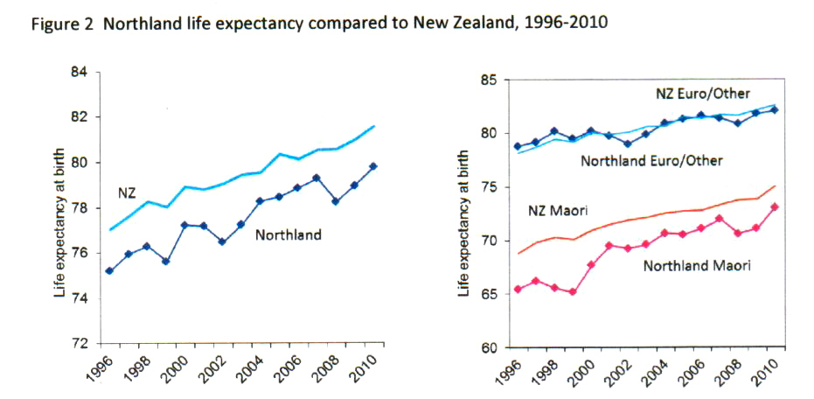
Life expectancy
Goal : From a difference of 14 years to a difference of 9 years
Rheumatic Fever
Cardiovascular Disease
Sudden Infant Death Syndrome
Cancers
Gout
Mental Health Issues
Suicide
Diabetes
Chronic Respiratory Disease
Notes:
These are the diseases that indigenous Maori experience in Northland though there is much evidencing highlighting improvements in equitable health outcomes and showing progress and changes as a direct impact of programs intersectoral efforts.
The graph identifies the health conditions that Maori are more likely to experience than non- Maori and highlighting the inequitable health difference results in a life expectancy difference of 9-14years, Significant efforts have been made to respond to patients more equitably and thus the differential gap is slowly beginning to close.

Slide 10
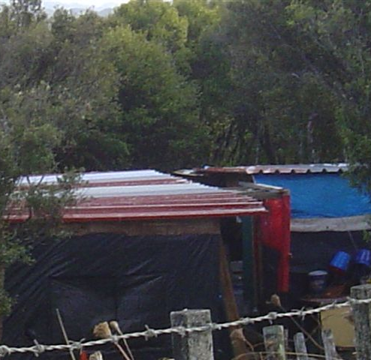
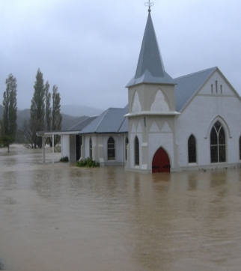
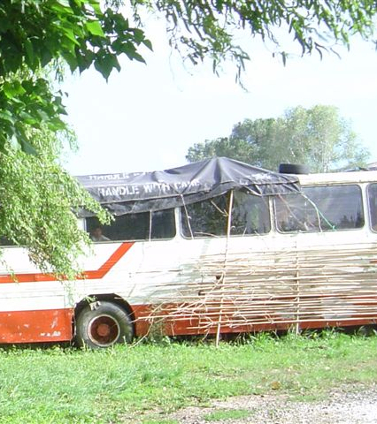
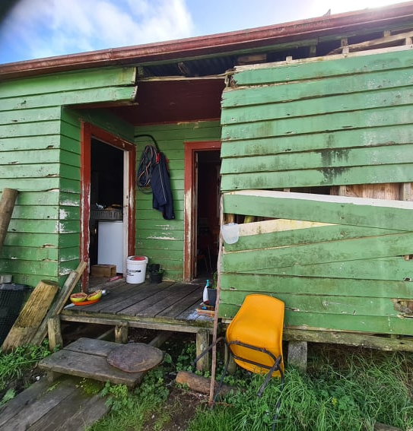
Health and wellbeing affected by rurality housing, roading, flooding etc.
Notes:
Living in Northland has some tough realities- These homes are in our Northland locality. The church is well known in the small community of Kaeo which has a tidal river running through it and in times of heavy rain, the community experiences frequent flooding.
The health context shows that 35% of the population are Maori
More than one third of the population live in high areas of deprivation where distance from services of health, education, employment, trade services etc are difficult to access
Rates of illness and mortality for Maori are higher than non-Maori .
Conditions causing death include stroke, ischaemic heart disease , lung disease and diabetes , is a great challenge.
We acknowledge that indigenous populations globally expound similarly , increased rates of mortality, morbidity and disability.
Whilst Maori experience higher rates of illness studies show:
They access primary health care less
Have less tests and investigations ordered , with less follow up than non- Maori.
Maori avoid seeking health care or present late in their disease process and they miss vital cues to changing health conditions, they are shy , or unable to articulate their health needs clearly or they maybe embarrassed about their poor health circumstance
These outcomes provide the clues , rationale and the drivers for the need for transformational health change.

Slide 11

NZ Epidemiologist
Dr Juliet Rumball Smith
Leads out with the instruction that services can approach inequitable health outcomes in three specific ways:
1. Through addressing systems
2. The patient or individual themselves
3. The patient provider interaction
Notes:
NZ Epidemiologist Dr Juliet Ruball Smith
Leads out with the instruction that services can approach inequitable health outcomes in three specific ways:
1. Through addressing systems
2. The patient or individual themselves can initiate their own development or change
3. Service can focus on the patient provider interaction
As a strategy to address inequitable health outcomes we have implemented programs and projects to manage our systems
A number of national strategies addressing these issues including intersectoral / issues and taking a multipronged approach has been in progress for some years
The patient has been on occasion blamed for their circumstance and efforts have been made to support ‘self management’
Juliet Rumball Smith reminds us that there is greatest and significant influence in approaching strategies that focus on the patient provider interaction.
Hidden in plain sight is the

Slide 12

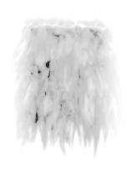
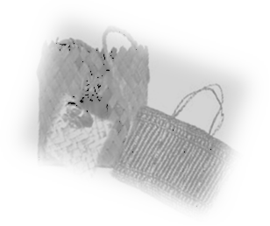

Why Te Hononga?
Why these steps ?
Firmly grounded in culture
Aligns well to standard of medical practice
Relevant
Positive impact on patients
Share
Access for
Whole of family to
Whole of services
Whanau ora
Action
Competent clinical
intervention
Hauora
Connect
People, Places
Processes
Whanaungatanga

Slide 13
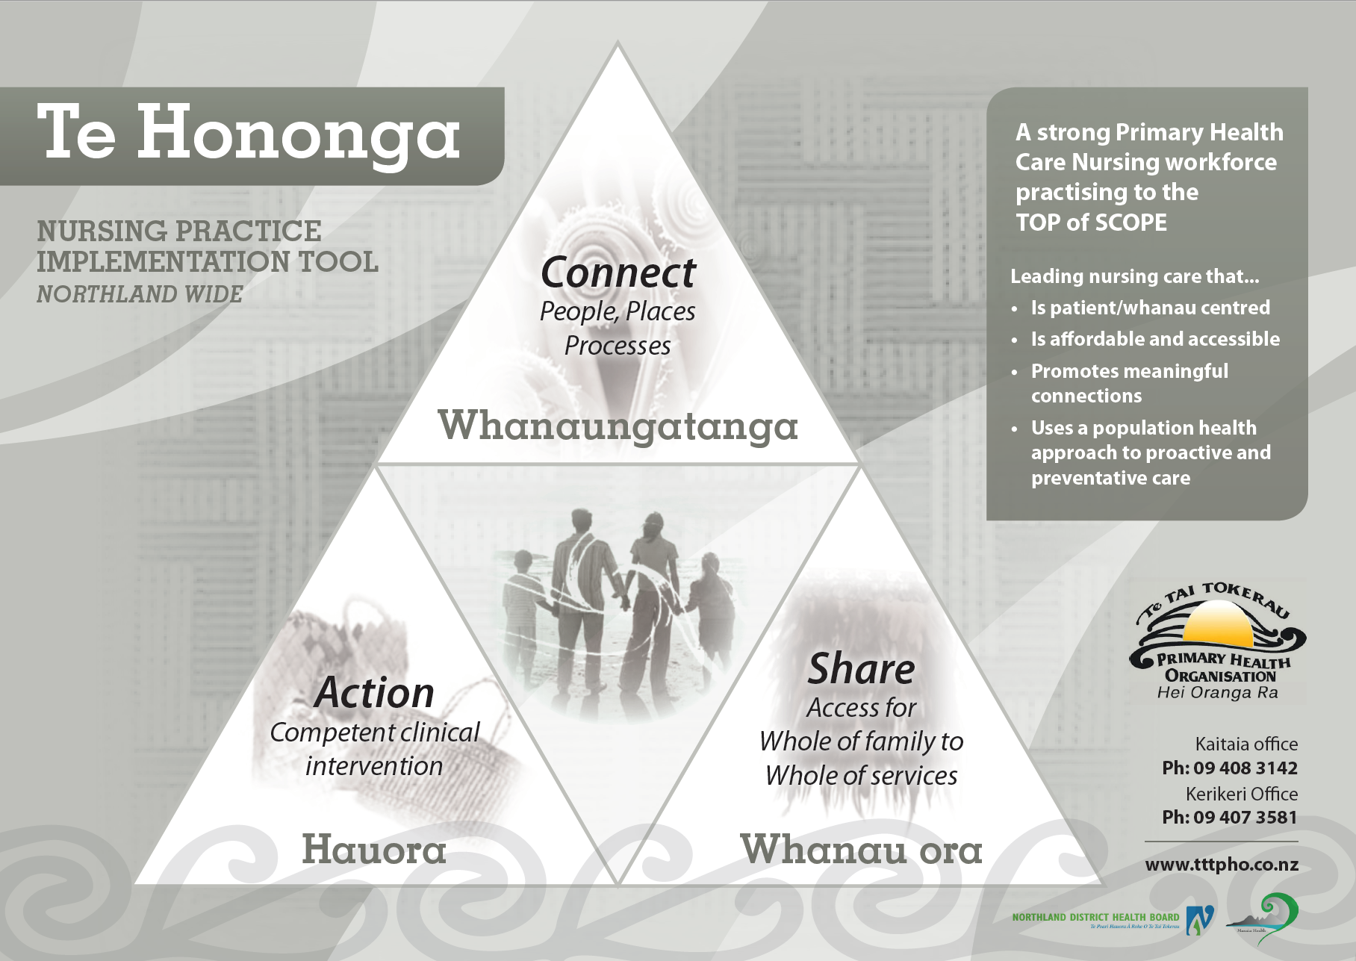

ASK
BUILD
CHECK

Slide 14
Meihana Model
Steps in the encounter
Closing the session
Prepare patient to share their experience with their whanau
Referrals
Purpose
Access resources
Address health needs
Answer questions
Develop new skills
Led patients to own healing
Making a connection
grow confidence to open the flow of warmth , trust and communication
Initial greeting and engagement
Mihimihi
Whakawhanaunga-tanga
Kaupapa
Poroporoaki /
Whakamutunga
Hui process : https://www.researchgate.net/publication/221740759
Meihana Model: Pitama, P. R.-K. (2007). Meihana model a clinical framework (Vol. 36). Christchurch , New Zealand : New Zealand Journal of Psychology .
Powhiri Poutama : Paraire, H. (2011)
Notes:
Durie laid foundations for other developments such as The Meihana Model (Pitama, S. Huria,T. Lacey,C, 2014), expanding on the dimensions of Te Whare Tapa wha, providing recommendations for enhancing Dr or Nurse - patient relationships with Maori. The Meihana Model outlines four steps in the engagement, these being mihimihi (initial greeting engagement) whakawhanaungatanga (making a connection) Kaupapa (attending to the purpose of the encounter) and poroporaki, whakamutunga (closing the session). It expresses the interweaving of Maori beliefs and values to optimise and authenticate that experience.
More than process steps in engagement these are welcoming door openers to the intimate individual heart spaces where real communication happens. Part of the reason why a person doesn’t feel heard is because the form and style of communication is so different they don’t feel understood. Realising that particular communication feature difference, between Maori and non-Maori, will inform the importance of drawing attention to the detail of Mihimihi, Whanaungatanga, Kaupapa and Poroporoaki- Whakamutunga, as a rich encounter of engagement and not just a step in a twenty-minute consult. Understanding that you aren’t going to get anywhere with the patient until that heart space is settled. This may slow the race in trying to get to an end point.
A Mauri ora moment will reorient listening, alerting oneself to identify what is really on their mind and not what is on our schedule or dashboard. The balance of these efforts encompasses the artful approach we term cultural competency. The management of such an artful moment in a tight timeframe may feel impossible.
Simple Maori words in a greeting; correct pronunciation of name; affirmation and acceptance through a firm handshake or hongi; accurate paraphrasing of comments; checking out understandings; formally creating a specific space for the right Kaupapa to happen; can all be achieved authentically in a few moments, if you maintain the importance of connection with people above tasks as the agenda. These are less about time and more about quality ‘use’ of time. To be able to achieve both clinical and cultural requirements through the master’s skilful negotiation, back and forth, formalising moments for proper responses to occur so that a flourishing of ideas can flow, a taking back of responsibility can occur and the thrill of being alive can be sensed. This would be a perfect scene for the unfolding of mauri ora.

Slide 15

Hidden in plain sight
Notes:
Hidden in plan sight there is the opportunity to shape our engagement skills and to breathe life into the patient experience
We have learnt that for Maori there is a really obvious thing to do that we can do, but nurses don’t do it
This is to see every encounter as a Mauri Ora encounter – an opportunity to breathe life into the patient- encouragement ……to bring into harmony a suite of skills that operate simultaneously in a nurse who is finely attuned and aware of the role they play in lifting and sustaining the patient to a position of power and self efficacy for personal leadership.
This contribution will bring the patient back to you voluntarily. They will negotiate with you their challenges and take a stronger lead in their journey. With your trust and respect for their preferences and values demonstrated in the way you give yourself to this brief moment will make a difference and reduce time in other areas and matters of their care,
In a clinical environment where there are pressures and limited time, one might forgo this opportunity to enlist the patient, sacrificing the moment for richness in exchange for the satisfaction to move onto the next task.
Feedback from clinicians/ nurses just like yourselves include
Limited time to address multiple complex issues
Feeling overwhelmed
And limited capability to adapt to new information
Hidden in plain sight is the opportunity to recognise that we as nurses are keepers of a vital ingredient to unleashing the untapped contributions of the patient themselves simply by connecting with them, with the expression of how thrilled you are to see them.
The expression of Mauri Ora- is not a tool to make people feel happy
But an opportunity to express that you are thrilled to see them. This subtle difference communicates a sense of value.
People need to feel like they are going to have a positive, meaningful and relevant health experience with you.
The encounter with the patient is to not skip over the value of deepening connection, to really listen , to really focus on them and to breathe life, hope and encouragement to lift patients so they are permitted to make decisions that advance their progress to positive health benefit.

Slide 16
Camara Jones
Camara Jones –
There are differences in social determinants of health for everyone
There are differences in access to services for everyone
Differences in the quality of health care.
Notes:
Studies in NZ highlight that clinicians, including nurses , treat Maori differently from non-Maori. Cultural competence and unconscious bias significantly influence the quality of health care for Maori who experience the worst health outcomes of the NZ population.

Slide 17
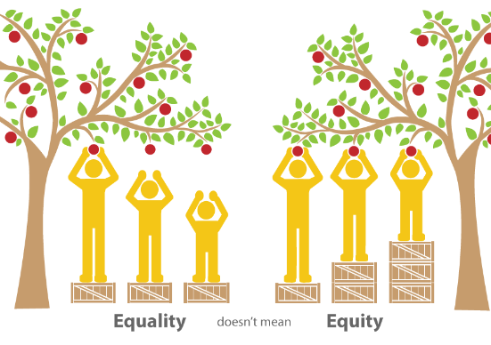
Notes:
Equals must be treated equally (a) and unequals unequally (b) according to their relative inequality
Aristotle
The overall imagery is saying that some people need more resources than others to reach the fruit.
Giving people exactly the same service and resources won’t achieve equal outcomes.
For example…
The fruit could be getting to an appointment on time – easy for some, not easy for others.
The fruit could be having a cervical smear.
The fruit could be giving up smoking.
The fruit could be exercise or losing weight.
It could be taking medications on time, every day.
If you provide equal services or equal boxes for everyone, some will reach the fruit and some won’t.
The boxes could be time, or resources, petrol vouchers or a combination of all of those.
The boxes could be your health literacy skills and approach.
The boxes could be spending just a little more time and effort connecting with your patient.
The fruit could be moving steadily toward self management. Not everyone will get there with the same boxes.

Slide 18
Equity
Equals must be treated equally (a) and unequal's unequally (b) according to their relative inequality
Aristotle
Notes:
Nurses are in the influential position to review their role in ensuring that ‘unequals are resourced equitably’ to achieve the same health outcomes as others, by
bringing services closer to the people,
by ensuring fairness in consultation offerings,
including diagnostics and investigations,
offer medications,
follow up visits
Provide more referrals to specialists as required,
identify barriers of cost and access, by checking capability and resourcing with the patient
Employ Health literacy approaches:
Ask what they know
Build on what they know
Check what they know

Slide 19
Every time a person enters your space, seeking your care and attention, you are being presented a window of opportunity , a chance, a moment, a break
Poipoia te kakano
kia puawai
Nurture the seed
and it will blossom
Notes:
The patient engagement opportunity is the window we refer to;
Each time a patient enters the therapeutic space seeking nursing care and attention a powerful window of opportunity. The engagement tool is called the Mauri Ora window providing the practitioner with a toolkit of triggers to routine best practice engagement , nurturing optimal therapeutic rapport in interactions with all patients, though is particularly relevant to use with patients who have a different cultural background to themselves. It highlights the importance to be more vigilant.

Slide 20
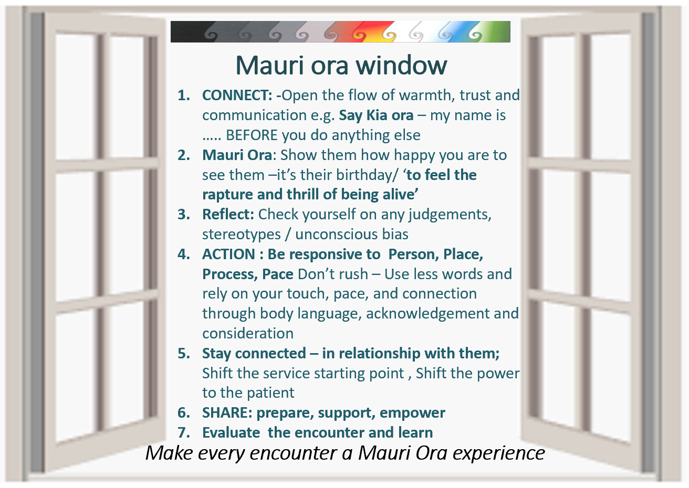
Notes:
This is a glimpse of the Mauri ora window ,which I am now going to break the components down by presenting them individually.
The points I make now may provide a checklist of competency touch points you may want to evaluate that comprise the skills for a successful Mauri ora encounter.

Slide 21
1. Connect
Kia ora/ Say hello – my name is
Correct pronunciation of a name
Firm handshake or hongi
Check out understanding
Create a specific space for the right processes to occur
Less about time – more about quality use of time
Put people above tasks
Notes:
This image is a formal greeting in our culture where our noses and forehead touch symbolising one mind , one breath - (obviously preCOVID)
Connect in a way that Is meaningful to them and authentic to you
Open the flow of warmth , trust and communication.
Introduce yourself – say hello in your language and say my name is…..
Simple Maori words in a greeting; correct pronunciation of name; affirmation and acceptance through a firm handshake or hongi; accurate paraphrasing of comments; checking out understandings; formally creating a specific space for the right Kaupapa to happen; can all be achieved authentically in a few moments, if you maintain the importance of connection with people above tasks as the agenda. These are less about time and more about quality ‘use’ of time.
To be able to achieve both clinical and cultural requirements through the master’s skilful negotiation, back and forth, formalising moments for proper responses to occur so that a flourishing of ideas can flow, a taking back of responsibility can occur and the thrill of being alive can be sensed. This would be a perfect scene for the unfolding of mauri ora.
In the absence of systems and practices designed to welcome whanau participation in their health care as a respected member of their own health team the general practice may operate more like a machine , processing a person’s health care needs valuing efficiency over the valuable opportunity presented to strengthen Self Management skills – to ensure that patients leave the care experience more Able, Informed, Motivated and Supported.

Slide 22
2. Mauri ora
Breathe life –help them to feel the thrill of being alive
Show them how happy you are to see them
It’s their birthday
They may come with their own biases feeling guarded, protective, and their lived experience of being poorly treated in the health system or feeling on the ‘back foot’.
Your response can change this view.
Notes:
Breathing life in the opportunity
Breathing Into the engagement
Breathing Into the human interaction
Break down barriers :
This maybe one of the few times where someone in the system said to them
I am so happy to see you
Rather than – what can we do for you today.
We may discount that we don’t have time to set an agenda , however researchers estimate that the process adds just 1.9 minutes to the length of a visit on average
Show them how happy you are to see them
It’s their birthday
They may come with their own biases feeling guarded, protective, and their lived experience of being poorly treated in the health system or feeling on the ‘back foot’.
Your response can change this view.
Use this opportunity to set the agenda for the encounter together to convey interest in what matters to them a dn invites them to take an active role in the discussion.

Slide 23

3. Reflect
We need to maintain a vigilance to detect our own and other’s biases
Ann McKillop
How do you know when you have an unconscious bias?
‘An unconscious bias maybe manifested in our little irritations, impatience, blind spots.’
Hemaima
Notes:
The art of critical reflection is a nurses best friend
Many clinicians are unaware of problems.
We need to maintain a vigilance to detect our and others biases
How do you know when you have an unconscious bias ?
Common biases : Racial / gender / Obesity/ Age/ Psychiatric illness/ Drug and Alcohol dependence / Socioeconomic status / sexual orientation / chronic and complex illness
Ann McKillop

Slide 24
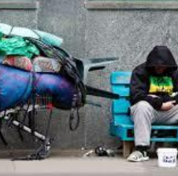
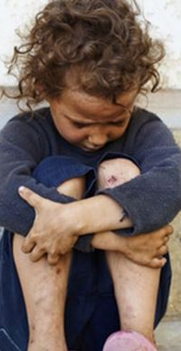
Our unconscious bias is experienced by the patient
in our touch, our pace, the tone of our voice or movements around them, our body language and eye contact
Notes:
Culture matters

Slide 25
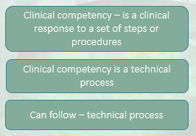
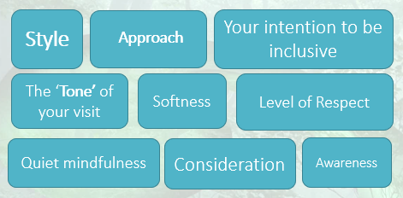
Clinical Competency
The Science of our work
Cultural Competency
Is the Art of our work
Culture matters
Notes:
Culture matters . Culture provides the context of what is important to the patient.
Cultural competence – everyone’s responsibility
All around the world nurses will respect the same best practice protocols to conduct a Head to toe assessment, to complete a cervical smear , to run a Cardiovascular Risk assessment – This is the science of our work
But everyone of us will add our own personal flare and style to tailor the experience for the patient perfectly. We will apply our authenticity to the moment, speak firmly, or softly as required and move in the space as we breathe life into the moment to make things easy for the patient, gain their trust and respect and elicit their own leadership. This is the cultural competency aspect of our work .
We all seem to be hoping for cultural expertise . The challenge for nurses around cultural competency is to recognise that everyday we can gain a little more cultural knowledge, and extend ourselves to understanding more of their world view and lived experience to know a little more about people BUT not necessarily to be like them
Culture is all about the craft of your work , it is the style , the approach , the softness/ the consideration/ the level of respect / the tone of your visit with the patient/ your intention to be inclusive/ to assist the person to understand and to be understood / awareness / quiet mindfulness and your willingness to respond in a way that assists transformation.

Slide 26

4. Clinical Action
Be responsive to the Person,
in the Place where you find yourself performing your nursing support,
through Processes that make and maintain connection,
Pace: Don’t rush – Use less words and rely on your touch, pace, and connection through body language, acknowledgement and consideration
Notes:
We are inclined to race and rush which impacts on our ability to perform our tasks smoothly and easily with the patient
Don’t rush – many patients express in patient surveys that they feel rushed
This window of opportunity is a nonverbal one, cultural in the context of the requirement to artfully and skilfully shape your support around the patient- reach out to them
It is a call to rely less on words and to raise consciousness of the non-verbal cues.

Slide 27
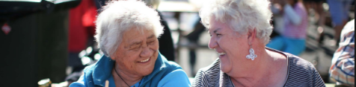
5. Stay connected, whilst shifting the power to the patient
Try again and again and again to stay in relationship
Critical reflection is key to stay moment by moment in connection with the person in front of you, through the processes you are engaged in.
    Recognise when a problem arises
    Accept your contribution to the change that can be made
    Consider your unconscious biases and how they play into your engagement so you can stay connected.
    The patient can be a great teacher in this moment- shift the power back to them.
    What matters to them?
    What can you learn?
    How can you work together?
Notes:
Try again and again and again to stay in relationship
Critical reflection is key
Recognise when a problem arises
Accept your contribution to the change that can be made
Consider your unconscious biases and how they play into your engagement so you can stay connected.
The patient can be a great teacher in this moment
What matters to them?
What can you learn?
How can you work together?
Shift the starting point of the service… this is not just shifting the locality of services but this distance can also represent heart space. Once in the same proximal space consider how you bring information and intervention to the patients level.
Consider how you shift the power from you as the dominate stronger person delivering care to making them the decision maker, in charge, the leader, the driver of their own destiny.

Slide 28
6. Share- prepare, support, empower
Inform patients - assist information sharing to strengthen family support
Progress and share referrals with other services for timely and effective care within the system
Notes:
If we share information we are preparing the patient to share their experience with their support or family network, empowering to take the lead in their own health journey.
Sharing information with relevant services, and making referrals, assists the patient to receive timely specialist care.

Slide 29

7. Evaluate the encounter and learn
  1. Relationship: I Feel understood, respected and or accepted by the nurse or Dr
  1____________________________________________________5
  I did not I did
2. Goals and topics : Work on or talk about what I wanted to work on or talk about
1____________________________________________________5
We did not We did
3. Approach and methods: The approach is not/is a good fit for me
1____________________________________________________5
Is not is
  4. Overall : There was something missing in the consult today -I did not feel or I did feel like I was part of the process today.
1____________________________________________________5
I did not feel I did feel
© 2007, Barry L. Duncan and Scott D. Miller : ORS Outcome Rating Scale
Notes:
Just as patients often struggle to implement and sustain behavioural change related to their chronic illnesses, nurses and clinicians may also struggle to change their communication skills .
Also as cultural competence is the artful responsive way to work with a whanau, the determination of quality and accuracy in treatment and approach to care is then reliant on the perception and experience of the recipient of the services rather than the nurses as the deliverer.
This takes vulnerability and courage.
Formally evaluating and reflecting on your encounter with the patient at the end of each visit will assist early adoption.
Duncan and Millers Outcomes Rating Scale provides a tool for reflecting on the patient- provider interaction. It is an easy and friendly tool that will assist you to adjust and refine your skills until they become a part of your natural skill set.
The questions call for a rating on
the quality of the relationship established – you breathed life into the encounter making the relationship an additional tool for successful address of health issues and making the consult easy to navigate/ cooperative etc.
Whether or not you work on or talk about the things that matter to them – the clinical test
That your methods and approaches were a good fit for them – culture test
Lastly – Check – was there anything missing
As we close the loop on our learning experience we lift our skills, sharpen and refine our cultural competency to see things in others and ourselves that we may not have recognised before and then take responsibility for improvement and change.

Slide 30
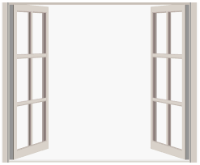

Mauri ora window
CONNECT: -Open the flow of warmth, trust and communication e.g. Say Kia ora – my name is ….. BEFORE you do anything else
Mauri Ora: Show them how happy you are to see them –it’s their birthday/ ‘to feel the rapture and thrill of being alive’
Reflect: Check yourself on any judgements, stereotypes / unconscious bias
ACTION : Be responsive to Person, Place, Process, Pace Don’t rush – Use less words and rely on your touch, pace, and connection through body language, acknowledgement and consideration
Stay connected – in relationship with them.
SHARE: prepare, support, empower
Evaluate the encounter and learn
Make every encounter a Mauri Ora experience
Reihana, H.(2019)
Notes:
Adopting these 7 steps into your practice will add to the success of the encounter – breathing life into the relationship and making each encounter a Mauri ora experience.
These are communication strategies that can be added to your existing skill sets.
They are not linear, and can be finely tuned to harmoniously work together, all at once.
Tiheiwa Mauri ora

Slide 31
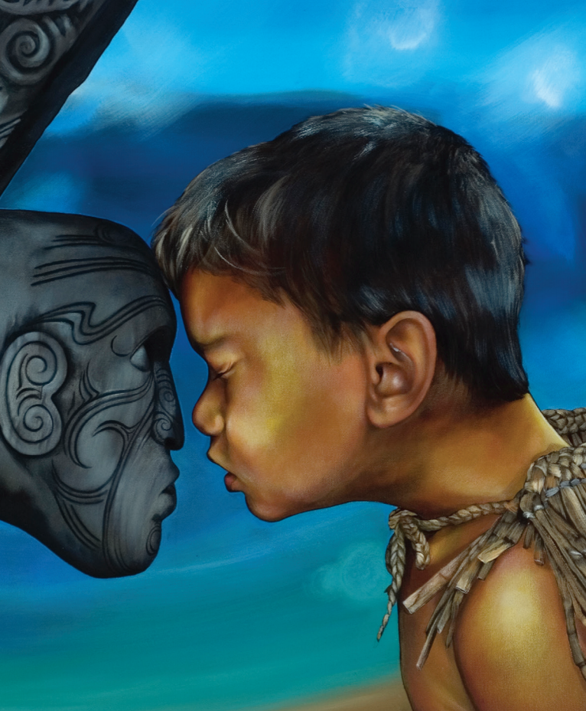
Thank you for listening
Tiheiwa
Mauri ora
Artwork by Theresa Reihana
Notes:
Where every you are in the world
May you feel of our spirit , may we be united as a human race through this trialling time.
May we be kind , safe and caring.
Tena Koutou Tena Koutou , Tena Koutou katoa

Slide 32
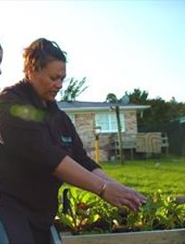
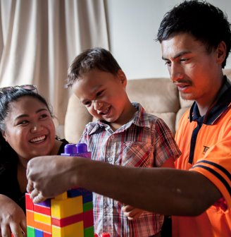

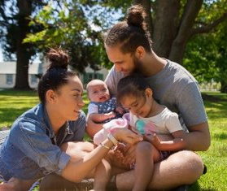
Mauri ora
Individuals and families flourishing

