Slide 3
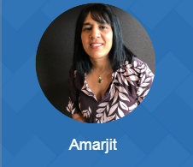
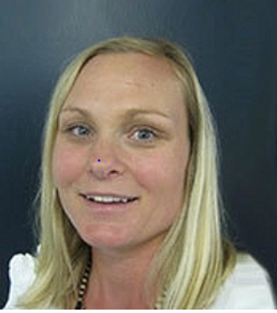
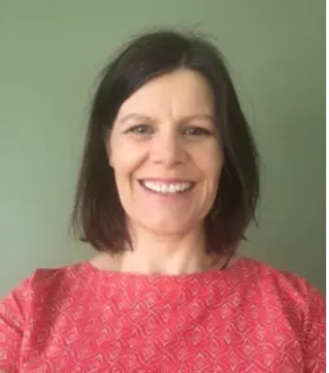
Supported by: The Health Care Home Collaborative Team including Kirsten and Jess Thanks to our network of leads and change facilitators that do the mahi with us!
YOUR HOST

Slide 4
Meet our panel

Slide 5
What we’re planning to cover….
Rachel – will provide some background on networks, the proposed future as part of the HDSR, the CCDHB vision and an overview of their current mahi within the Kapiti Community Health Network.
Cherie – having worked in the heart of the community alongside others and as an iwi representative will share the importance of partnering with iwi and the community. Focus on the benefits of using Māori models of care as a foundation for networks.
Chris – in his role as GP and Medical Director will share his clinical leadership perspective and how this can supports networks. Included will be a case study.
Paul – with his vast knowledge and experience will provide an overview on Collective Impact and the importance of leadership and culture in making positive shifts in the community.
Amarjit – to provide a preview of the toolkit that is being developed to support networks
Q&A – and “Call to action”

Slide 6
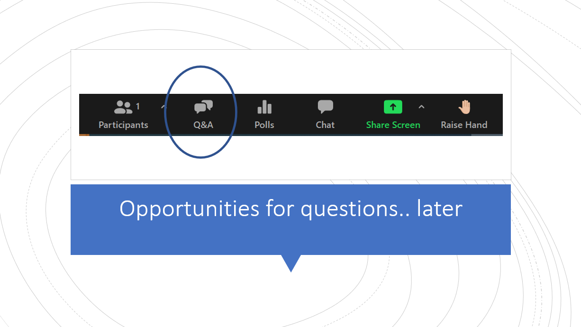
Question Time

Slide 7
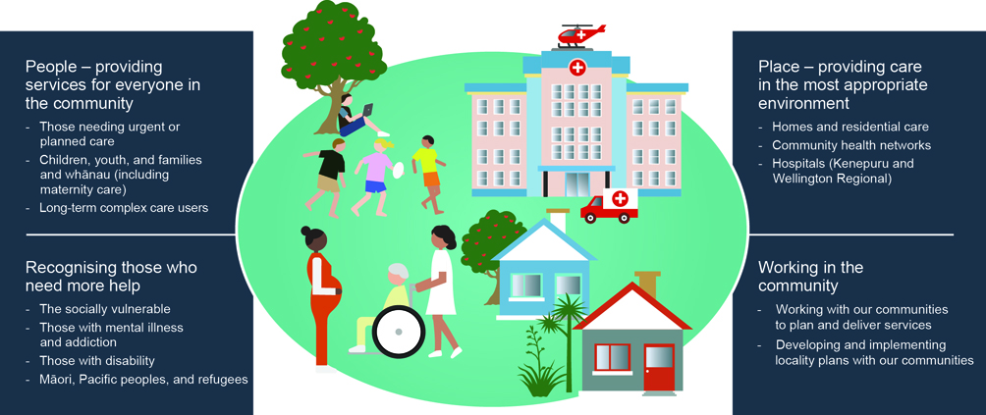
A Health System Plan focused on people and places
People
Place of care
- Hospitals (Hutt, Kenepuru and Wellington Regional)
Intensifying support for:
Māori
Pacific peoples
Those living with disability
Those with mental illness & addiction
Refugees
The socially vulnerable
Equity
Community
Notes:
Designing our health system – what do we want?
Our health system will keep our community healthy by:
Promoting health and wellbeing
Preventing the onset and development of avoidable illness
Improving health outcomes
Supporting people to lead better lives
Supporting the end of life with dignity

Slide 8
Health System Plan 2030
Notes:
What is the Capital Coast District Health Board’s vision and how does this fit with the recommendations of the Health and Disability Services review?

Slide 9
Ensuring consumers, whānau and communities are at the heart of the system
Creating a new networked approach to primary and community services (Tier 1).
Notes:
What is the Capital Coast District Health Board’s vision and how does this fit with the recommendations of the Health and Disability Services review

Slide 10
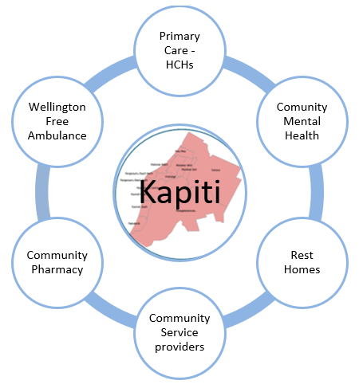
Creating a prototype.. Shared learnings

Slide 11
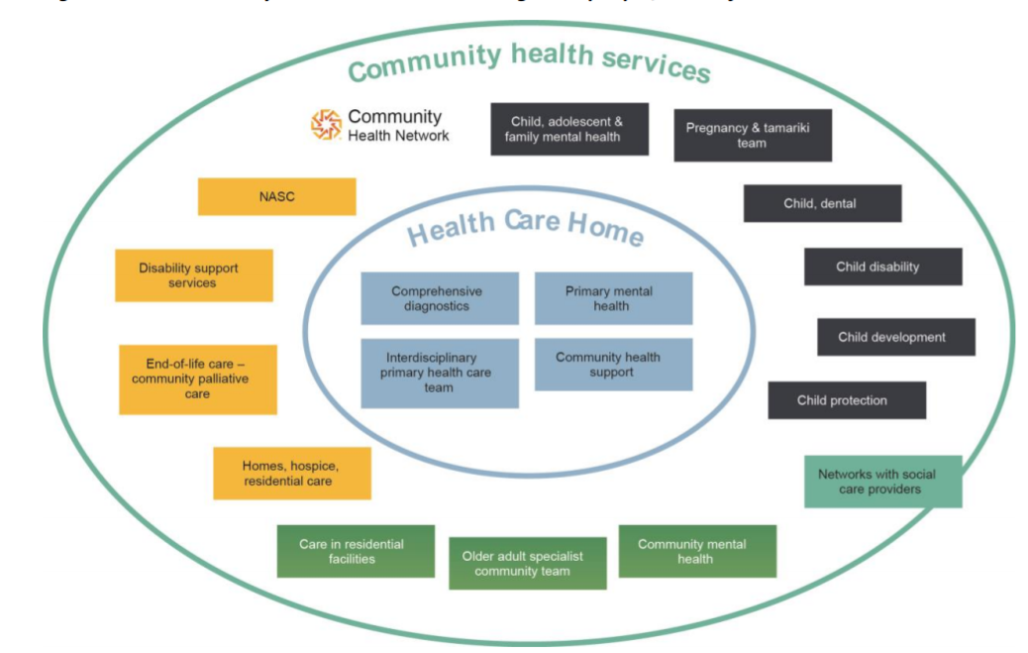
Community Health Networks organise delivery of a broad range of health services, and link to social service providers
Notes:
What are Community Health Networks?

Slide 12
Why Community Health Networks?
Improve the health and wellbeing of the local population:
Provide care that better meets the needs of a Network population
Strengthen relationships and improve connectivity and integration with providers in a Network
A supportive mechanism to coordinate and organise health service delivery within a defined area
Strengthen the system as a whole

Slide 13
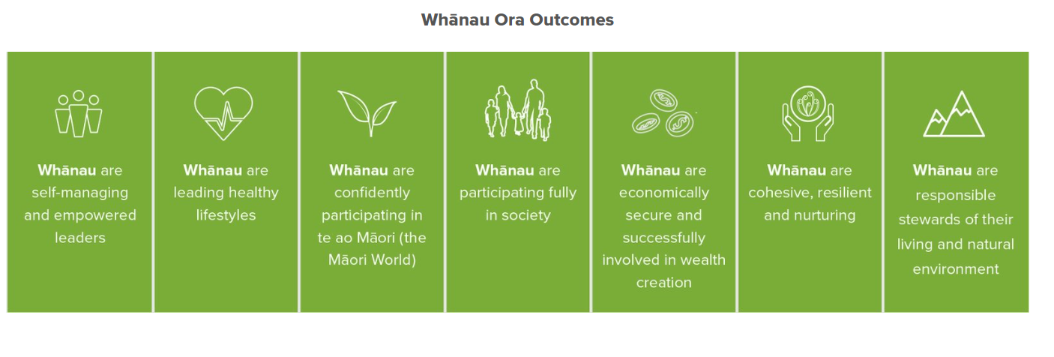

Slide 14
Te Whare Tapa Wha

Slide 15
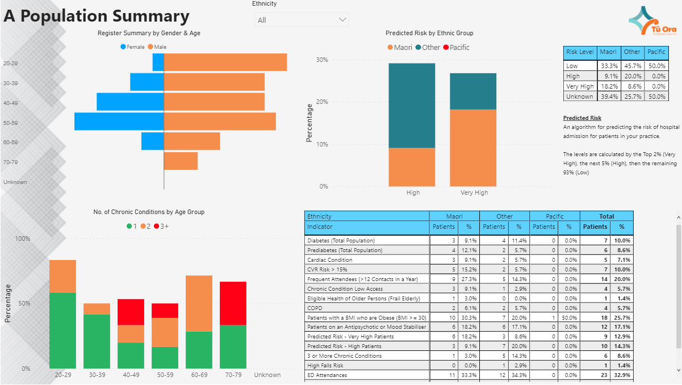
Te Whare Tapa Wha

Slide 16
https://www.healthcarehome.org.nz/download/model-of-care-a2-poster-links.pdf?inline

Slide 17
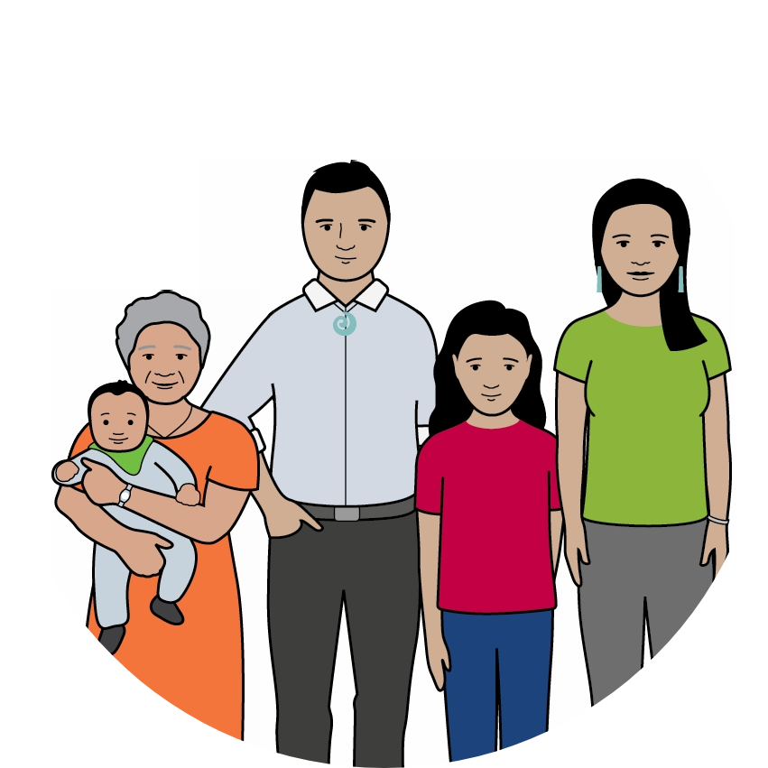
Creating a toolkit to get started…

Slide 18
Question time

Slide 19
Call to action…
He aha te mea nui o te ao What is the most important thing in the world?
He tangata, he tangata, he tangata It is the people, it is the people, it is the people Maori proverb
Kōrero
Start the dialogue / conversations with iwi and community “hold courageous conversations”
Whakawhanaungatanga
Strengthen relationships and connectedness “Collaboration moves at the speed of trust”
Share
Share your learnings – “the good, bad and ugly” let’s not re-invent the wheel

Slide 20
Our next Webinar will be 15th April 2021– Consumer engagement & involvement

