Slide 1
Hutt Union & Community Health Service
TE KETE HAUORA
PATIENT ADVISORY GROUP
29 April 2021
Sally Nicholl sally@huchs.org.nz Muriel Tunoho muriel.tunoho@outlook.com

Slide 2
Te Kete Hauora Patient Advisory Group
First established in 2018 for a diabetes improvement initiative which was part of HQSC Whakakotahi programme.
Patients identified by staff team
Structured face to face sessions
Sessions shaped around a basket of knowledge where staff and patients expertise, experience and ideas shared and valued
Re-established in 2020 initally using a workbook to collect and share knowledge due to social distancing
Currently focused on promoting fluvax and covid vaccination

Slide 3
Co-design in Practice –diabetes and exercise session
2 hours face to face session including lunch
Quality tools learning session on PDSA cycles (30 mins)
Exercise and diabetes – Physiotherapist (30 mins)
Patients decided they wanted to design an exercise group alongside a physio and nurses and do this as a PDSA
Very excited by this – ideas flowing, offers to find a name, get music, promote to others, get whanau involved
Workplan decided
Toiora group started 1 monthly later

Slide 4
Te Kete Hauora: Patient Co-design

Slide 5
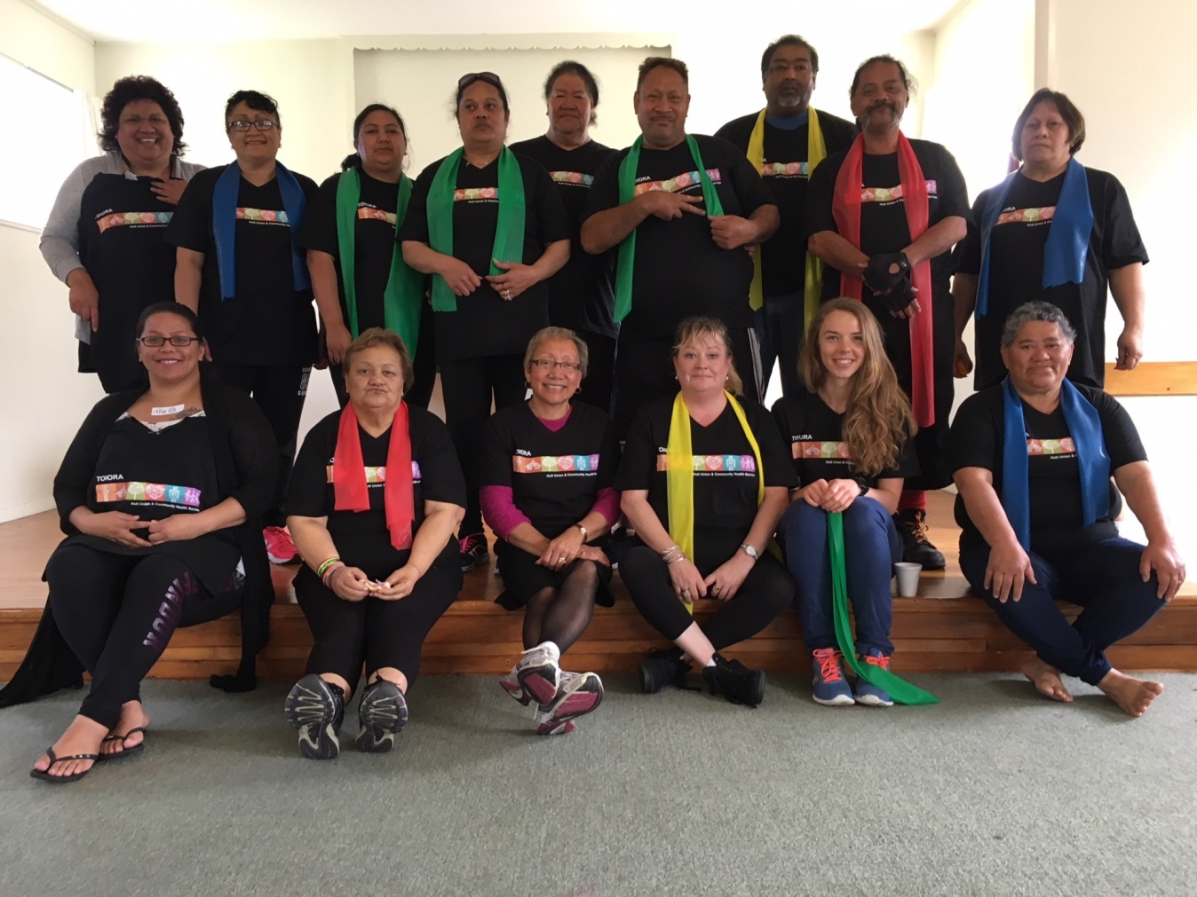
Toiora: An Exercise of Co-Design

Slide 6
Top Tips
Co-design is fun!
Manaakitanga – be intentional about creating a safe and comfortable environment for patients and staff where their contributions and leadership are genuinely valued
Whanaungatanga - relationships, respect and trust are important and may take time to build
Invest in your co-design group - plan sessions carefully, ensure you have the right skills in the room, and make your focus clear
Using QI tools is helpful and gave structure to our sessions
Both structure and flexibility are important. Know when to lead and when to step back

