Slide 1
A different kind of self care
Stay home
Practise social distancing
Wear a mask
Wash/sanitise hands
Use the Covid Tracer App or sign in
Notes:
New Zealand has demonstrated the ultimate in self care over recent months. We are at level one because of this. We were given top level advice regarding self care and practised it

Slide 2
self care = whanau care = community care
Notes:
Through 2020 we have had opportunity to learn that self care is actually whanau care and ultimately community care. If we can each be responsible for ourselves we can affect the health of our family and also an entire country. Thanks in part to 5 million people practising self care we currently enjoying the freedom of being at level one.

Slide 3
Reflecting on wellbeing
How have you been through 2020?
What has helped you through this time?
What values did you draw on?
What values were challenged through this time?
Notes:
How did you do this? What values did you draw on? What values were challenged through this time?

Slide 4
Reflections from a HIP practice
I started walking every day and have kept this up/I stopped going to the pool and haven’t started back again
We had meals together as a family but don’t do that anymore – we are too busy again

Slide 5
Reflections from a HIP practice
I need people around me / I prefer time on my own
I need routine / I thrive on change
Family is the most important thing in my life / work is the most important thing in my life

Slide 6
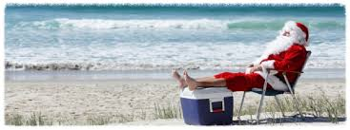
“What we all deserve is a great Christmas”
Notes:
New World ad…

Slide 7
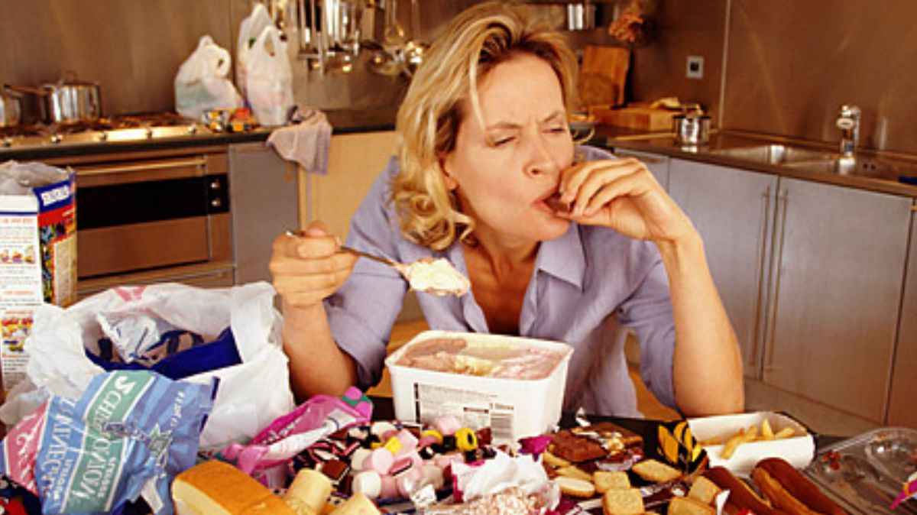
Notes:
However generally when people say this when they are about to do something that may not be the healthiest choice for themselves or are encouraging someone else to do so
eg unhealthy food choices, spending big on an item, opening a second bottle of wine

Slide 8
What nourishes you
What foods/drinks help your body work at its best?
Who of the people you spend time with brings out the best ‘you’
What movement does your body enjoy?

Slide 9
What is rest full for you?
What feels restful to your mind?
What feels restful to your body?

Slide 10
Aroha mai, aroha atu
Love received demands love returned
Notes:
Hinemoa Elders new book - describes how this whakatauki speaks to her about receiving love and creating a deliberate daily practice to remind herself of the energy of this love every day.

Slide 11
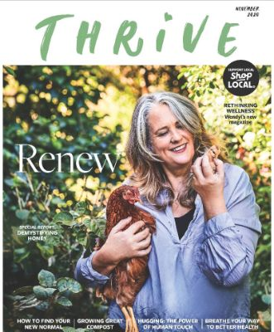
Wellbeing gift ideas

