Slide 1
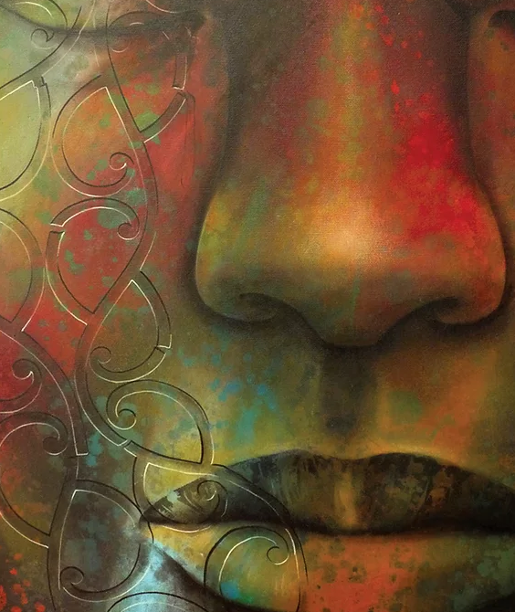
Tiheiwa
Mauri ora…
Life to you
Atua breathed life into man
He sneezed
He became ….
This presentation has been prepared for you:
Hemaima Reihana-Tait
Nurse Director -Mahitahi Hauora
Ph 021 1187404
Hemaima.reihana-tait@mahitahihauora.co.nz
Artwork: Theresa Reihana
Notes:
The ancient ancestral story of mankind, passed on to me, tells of the creation of humans fashioned from the dust of the earth formed and shaped.
Then the creator breathed into the form of humans to which they took in the breath of life, and sneezed …. Tiheiwa Mauri ora….
This is the expression that came from my ancestors , marking the moment that breath came into humans and now from then till present day we greet each other with
Mauri ora – life to you.

Slide 2
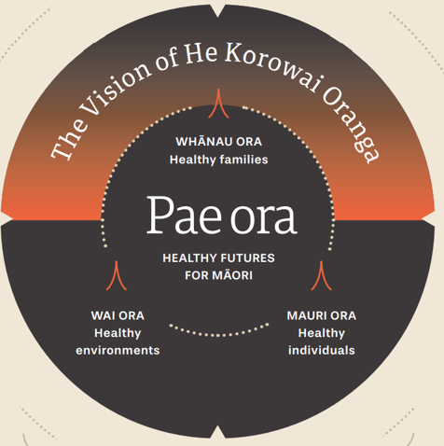
Pae Ora
Healthy Futures
Mauri Ora
Healthy individuals
Whanau ora
Healthy Families
Wai ora
Healthy environments
Notes:
Pae Ora – Healthy Futures for Maori, is presented to us by the Ministry to inspire us with direction and guide the pathway leading to healthy futures for Maori
By responding professionally / clinically/ humanly -with an awareness of our contributions to supporting
Mauri ora – Healthy individuals
Whanau ora – Health Families
Wai ora – Healthy environments

Slide 3
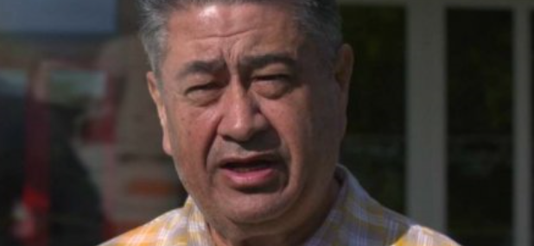
Mauri ora
Tamati Krueger
‘Mauri ora is feeling the thrill of being alive.’
In this place where the rapture of life is full, mauri ora can be restored and sustained. This comes from unconditional acceptance of who they are , others understanding what is important to them and having self efficacy to determine life direction’
Notes:
Tiheiwa Mauri ora – Atua breathed life into man – He sneezed , He became …..
With breath came life – so we recall that and celebrate … Life to you.
Tamati Kreuger is a well respected Elder from Tuhoe-
Mauri ora he says is feeling the thrill of being alive.’
In this place where the rapture of life is full, mauri ora can be restored and sustained. This comes from unconditional acceptance of who they are , others understanding what is important to them and having self efficacy to determine life direction’
Consider a time when you felt life breathed into you from :
Your family and friends – perhaps it was your birthday and you just knew that every effort was made to focus on you
Perhaps Your colleagues and employer, other nurses in your team, or services in your network celebrated a significant achievement
Do you recall the elation, the appreciation, perhaps the value of your contribution. Do recall the emotion, the high, the unconditional acceptance from them of who you are?
Did that celebration put wind in your sails, did it carry you a few days, did it make you feel hopeful, valued and more able. Did it empower you, strengthen you and give you permission to try again and expand yourself.

Slide 4
NZ Epidemiologist
Dr Juliet Rumball Smith
Leads out with the instruction that services can approach inequitable health outcomes in three specific ways:
1. Through addressing systems
2. The patient or individual themselves
3. The patient provider interaction
Health equity
2. Individual, whanau or population
3. Health workforce
1. Health system & services
Notes:
NZ Epidemiologist Dr Juliet Rumball Smith
Leads out with the instruction that services can approach inequitable health outcomes in three specific ways:
1. Through addressing systems
2. Recognise that the individual themselves can initiate their own development or change
3. Services can focus on the patient provider interaction
As a strategy to address inequitable health outcomes we have implemented programs and projects to manage our systems
A number of national strategies addressing these issues including intersectoral / issues and taking a multipronged approach has been in progress for some years
The patient has been on occasion blamed for their circumstance and efforts have been made to support ‘self management’
Juliet Rumball Smith reminds us that the most significant point of influence for change is to manage our own approach to the patient for there in lies significant power in the bond between you and the patient.

Slide 5


Hidden in plain sight
Notes:
Hidden in plan sight there is the opportunity to shape our engagement skills and to breathe life into the patient experience
We have learnt that for Maori there is a really obvious thing to do that we can do, but we don’t do it
This is to see every encounter as a Mauri Ora experience– an opportunity to breathe life into the patient- through encouragement and authentic engagement ……to bring into harmony a suite of skills that comes into play when we realise the mana that exists in the power and influence of that relationship. When we tune ourselves into the experience of the person, realise the role we play in lifting and sustaining the patient to a position of power and self efficacy for their own personal leadership- things can change.
This kind of contribution will bring the patient back to you voluntarily.
They will negotiate with you their challenges and take a stronger lead in their journey.
With your trust and respect for their preferences and values you can make a difference and you may reduce time in other areas and matters of their care,
Where there are pressures and limited time, in the rush of the moment you might forgo this valuable opportunity to enlist the patient as the driver to their own miracle of change, you may sacrifice the moment for richness in exchange for the satisfaction to move onto the next task.
Consistent Feedback from clinicians/ nurses just like yourselves include
Having Limited time to address multiple complex issues
Feeling overwhelmed
And having limited capability to adapt to new information

Slide 6
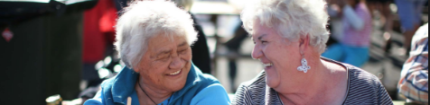
Unleash the untapped contributions of the patient themselves
Try again and again and again to stay in relationship
Critical reflection is key to stay moment by moment in connection with the person in front of you, through the processes you are engaged in.
    Recognise when separation or any distancing occurs
    Accept your contribution to the change that can be made
    Consider your unconscious biases and how they play into your engagement
Notes:
Hidden in plain sight is the opportunity to recognise that we are keepers of a vital ingredient which is to ‘unleash the untapped contributions of the patient themselves’ simply by connecting with them, with the expression of ‘how thrilled you are to see them.’
The expression of Mauri Ora- is not a tool or gimmick to make people feel happy
But rather an opportunity to express that you are ‘thrilled to see them’. It is to infuse every fibre of their being with your wish for ‘life to you’ – Mauri ora. This subtle difference communicates a deep sense of value.
People need to feel like they are going to have a positive, meaningful and relevant health experience with you.
The encounter with the patient is to not skip over the value of deepening connection, but to really listen , to really focus on them and to breathe life, hope and encouragement to lift patients so they are permitted and encouraged to make decisions that advance their progress to positive health benefit.
Try again and again and again to stay in relationship
Critical reflection is key
Recognise when a problem arises
Accept your contribution to the change that can be made
Consider your biases and how they play into your engagement so you can stay connected.
The patient can be a great teacher in this moment
What matters to them?
What can you learn?
How can you work together?
Shift the starting point of the service… this is not just shifting the locality of services but this distance can also represent heart space.
Once in the same heart space consider how can you bring information and intervention to the patients level.
Consider how you shift the power from you as the dominate stronger person delivering care to making them the decision maker, in charge, the leader, the driver of their own destiny.

Slide 7
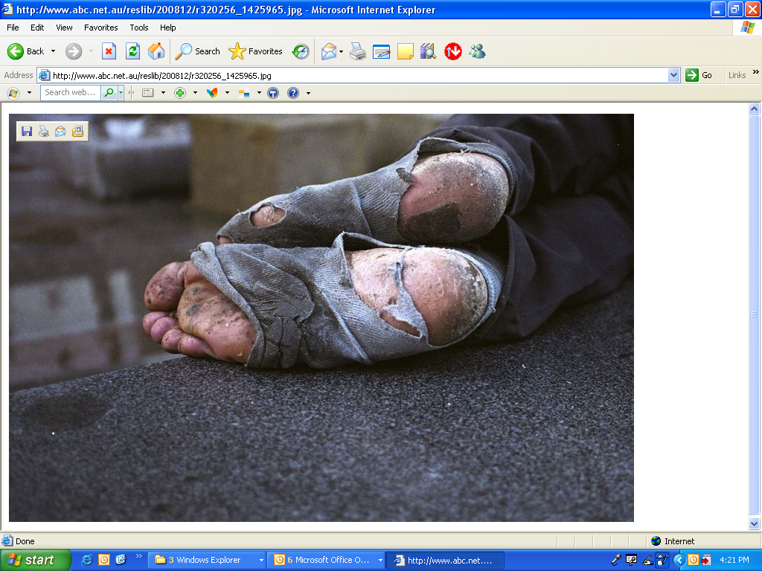
Unconscious Bias
Negative or positive feelings towards a person
Common Types
  Non-compliant patients
  Homeless patients
  Patients with chronic pain
  Obese patients
  Area or living conditions
  Ethnicity- Racism
Croskerry, P. Acad Med 2003;78:775-80.
Notes:
As we sharpen our awareness of the existence of our ‘biases’ we become less unconscious and become more empowered to consider the changes we can make in ourselves, by responding to the separations we create through our judgement of others because of our own values towards them.
Unconscious bias refers to the stereotypes both negative and positive, that exist in our subconscious and affect our behaviour.
Unconscious bias causes us to filter our clinical responses that can negatively affect the people we serve
Common types of unconscious bias maybe towards :
Non-compliant patients , Homeless patients, Patients with chronic pain, obese patients, area of living conditions of the person.

Slide 8

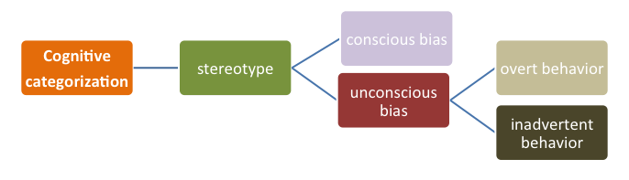
Unconscious Bias
Racism
Notes:
The patient catches a glimpse and sees through our professional fascade as soon as we roll our eyes, frown at the detection of a smell, reconnect with a previous poor challenging encounter, show our distaste for their appearance in anyway, or behave somewhat guarded as though they were bringing with them something you were not prepared to support.
Be it - Body weight, Smoker, skin colour, Job, Tattoos, Stigma relating to age, culture, sex, etc Racism too is a determinant of health for which even Ashley Blomfield states- ‘Evidence that racism at a range of levels does determine access to , experience of and outcomes in the health care system.
Our bias can be either conscious or unconscious and our expressions and behaviour either overt or inadvertent.
There is something about the detection of difference that is very quickly displayed in our fascial expression or body language that cannot be disguised …. Because The human touch is a poor liar
The patient has a finely tuned unconscious bias as well. They too have a sophisticated system of detectors that warn them of their own difference from you – so they caught you, before you caught yourself. They judged you too and in a split second they too began to respond to the distancing game that has been initiated by our behaviour.
There is a choice to be made here. It is a choice for connection or separation and it begins with our own awareness of our biases.

Slide 9

Reflect
We need to maintain a vigilance to detect our own and other’s biases
Ann McKillop
How do you know when you have an unconscious bias?
‘An unconscious bias maybe manifested in our little irritations, impatience, blind spots.’
Hemaima
Notes:
How do you know when you have an unconscious bias if you are unconscious?
We need to maintain a vigilance to detect our own and other’s biases -Ann McKillop
Yes you can learn to catch yourself. Our unconscious bias is manifested in our little irritations, our impatience our blind spots – I didn’t see that…..
Teach yourself to see what you couldn’t see before.

Slide 10
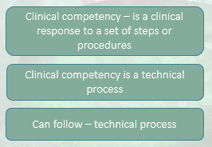
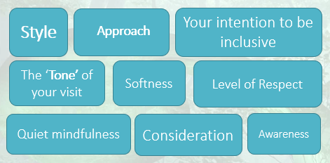
Clinical Competency
The Science of our work
Cultural Competency
Is the Art of our work and our own biases and privilege
Source: Hemaima Reihana-Tait
Notes:
Both Clinical Competency and Cultural competency is important in widening our awareness of the presence of implicit bias, stereotypes and judgements.
Clinical competency is the science of our work- we learn processes and procedures and teach ourselves to recognise important signs and symptoms of disease.
Detecting and responding to bias is both a practical clinical competency and needs the generous artful approach of cultural competency to respond with grace, dignity and compassion. Detecting and managing our biases is a technical skill that can be learned the same way we come to understand and to detect the presence of disease by the smell of a body odour perhaps breath, the discolouration of skin, the look of a posture, pace and gait of walking, sadness in eyes, the quiver of a voice,
The art of critical reflection should be called upon in every encounter as a clinicians best friend if Mauri Ora – breathing life into a patient provider interaction is to thrive and flourish.
Discuss – what is clinical competency ?- Examples
What do you do that is clinical?
Health promotion/ Education / Clinical intervention / Nutrition / Exercise / Activities / Rongoa
Kainga Pai / Kohanga / Nurse led outreach / After Hours / CVD/ PN/ Diabetes / Cx Smears / B4 Schools / immunisations / District nursing / Primary options / Smoking cessation / Chronic Care / FU Referrals / Home Visits
NHHT Other activities : Client history / Greetings / Clinical History / Best practice assessment / referrals /Treatment Linking / Explaining health results./ Screeening / blood tests / examinations / wound management / patience / listening / respect / empathy / history / family/ plain language / understanding / spirituality / engagement / surgical / consent / welcoming / appointments / nonjudgemental
What do you do that is cultural? How do you articulate this in practice ?
Culture is all about the art of your work , it is the style , the approach , the softness/ the consideration/ the level of respect / the tone of your visit with the patient/ your intention to be inclusive/ to assist the person to understand and to be understood / awareness / quiet mindfulness and your willingness to respond in a way that assists transformation.
NHHT Activities : knowing the community / Greetings intro / informed consent / Clear communication / Choices / Respect/ Privacy / Korero / Whakawhanaunga/ Whanau orientation / powhiri/ manaakitanga / whanaungatanga / whakarongo / respect / empathy / tika pono / aroha / whakapapa/ whanau / wairua / mate / tangi / kaumatua

Slide 11
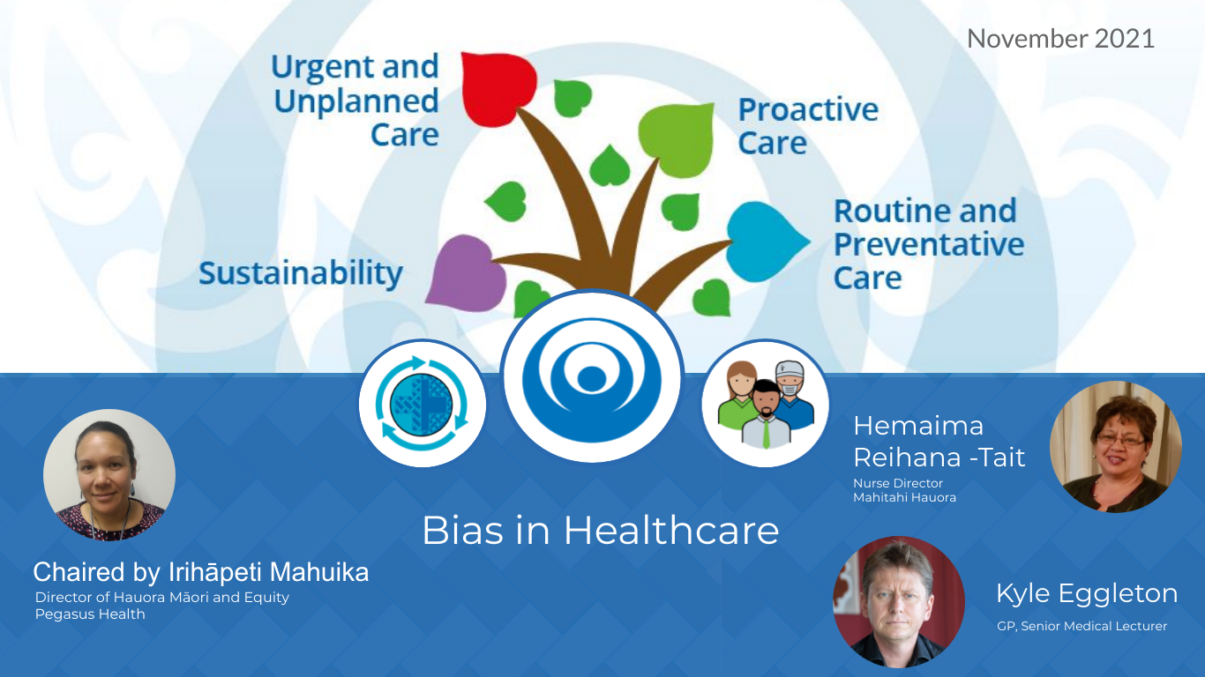
Notes:
At this point I am excited to hand over to Kyle Eggleton, one of my favorite Northland GP’s

Slide 12
End slides

Slide 13
Strategies include:
Clinical reasoning using self explanation
Present cases with feedback
Structured reflection (‘5 questions’)
What trap(s) can I fall into?
What else can it be?
Is there anything that doesn’t fit?
Is it possible that there’s more than one thing going on?
Is this a case where I need to “slow down”?
  Specifically: Should I switch to System II?

Slide 14

Evaluate the encounter and learn
  1. Relationship: I Feel understood, respected and or accepted by the nurse or Dr
  1____________________________________________________5
  I did not I did
2. Goals and topics : Work on or talk about what I wanted to work on or talk about
1____________________________________________________5
We did not We did
3. Approach and methods: The approach is not/is a good fit for me
1____________________________________________________5
Is not is
  4. Overall : There was something missing in the consult today -I did not feel or I did feel like I was part of the process today.
1____________________________________________________5
I did not feel I did feel
Call to action
© 2007, Barry L. Duncan and Scott D. Miller : ORS Outcome Rating Scale
Notes:
Just as patients often struggle to implement and sustain behavioural change related to their chronic illnesses, nurses and clinicians may also struggle to change their communication skills .
Also as cultural competence is the artful responsive way to work with a whanau, the determination of quality and accuracy in treatment and approach to care is then reliant on the perception and experience of the recipient of the services rather than the nurses as the deliverer.
This takes vulnerability and courage.
Formally evaluating and reflecting on your encounter with the patient at the end of each visit will assist early adoption.
Duncan and Millers Outcomes Rating Scale provides a tool for reflecting on the patient- provider interaction. It is an easy and friendly tool that will assist you to adjust and refine your skills until they become a part of your natural skill set.
The questions call for a rating on
the quality of the relationship established – you breathed life into the encounter making the relationship an additional tool for successful address of health issues and making the consult easy to navigate/ cooperative etc.
Whether or not you work on or talk about the things that matter to them – the clinical test
That your methods and approaches were a good fit for them – culture test
Lastly – Check – was there anything missing
As we close the loop on our learning experience we lift our skills, sharpen and refine our cultural competency to see things in others and ourselves that we may not have recognised before and then take responsibility for improvement and change.

Slide 15
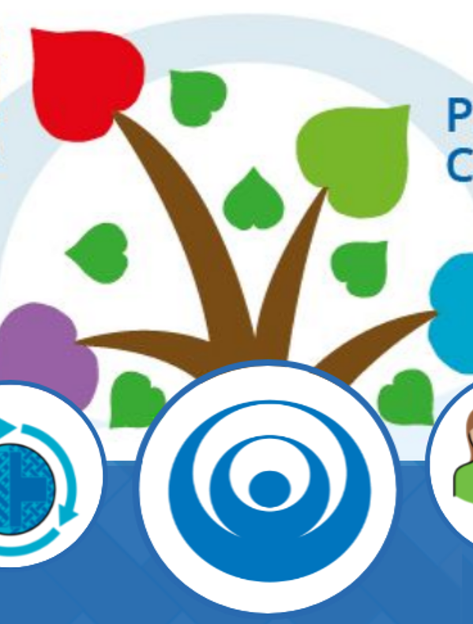
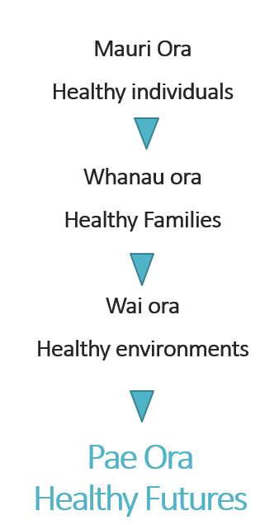
Pae Ora
Thriving and Flourishing

Slide 16
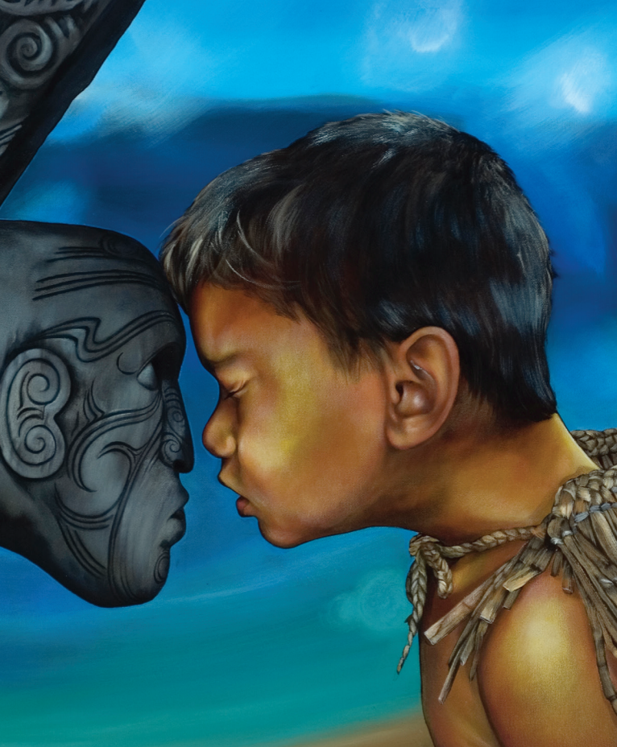
Thank you for listening
Tiheiwa
Mauri ora
This presentation has been prepared for you:
Hemaima Reihana-Tait
Nurse Director -Mahitahi Hauora
Ph 021 1187404
Hemaima.reihana-tait@mahitahihauora.co.nz
Artwork by Theresa Reihana

Slide 17
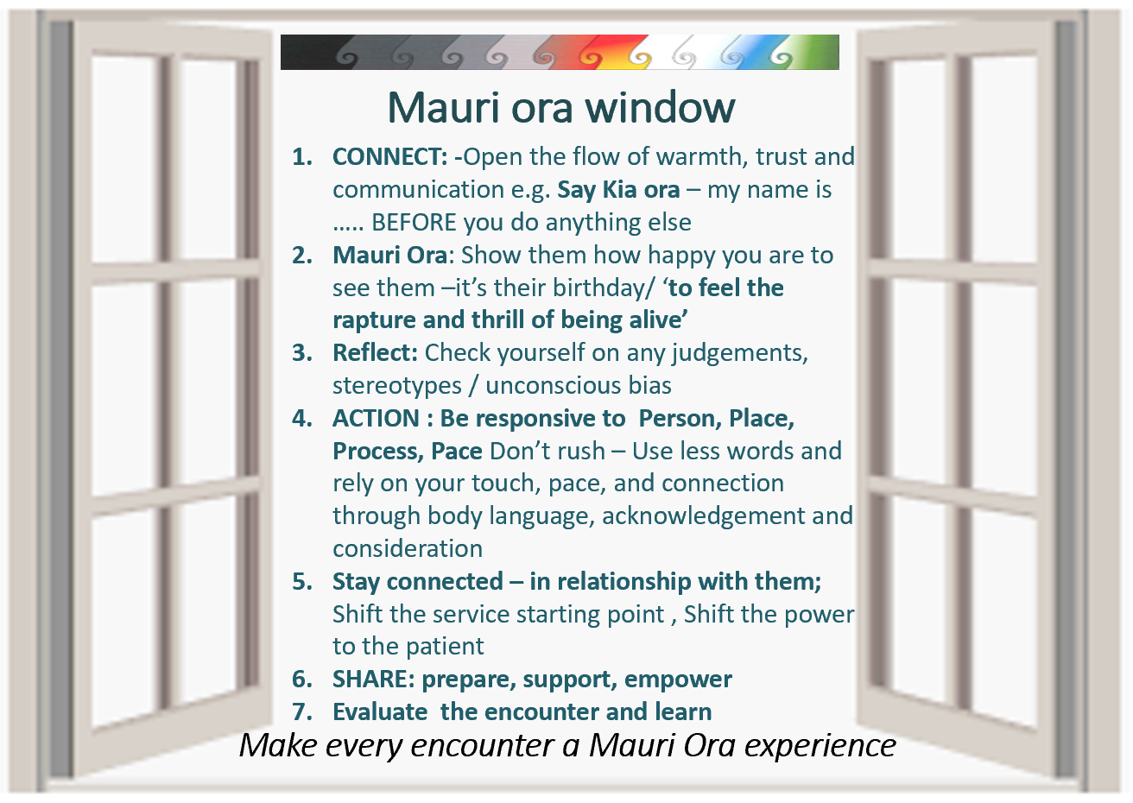
Notes:
This is a glimpse of the Mauri ora window ,which I am now going to break the components down by presenting them individually.
The points I make now may provide a checklist of competency touch points you may want to evaluate that comprise the skills for a successful Mauri ora encounter.

Slide 18
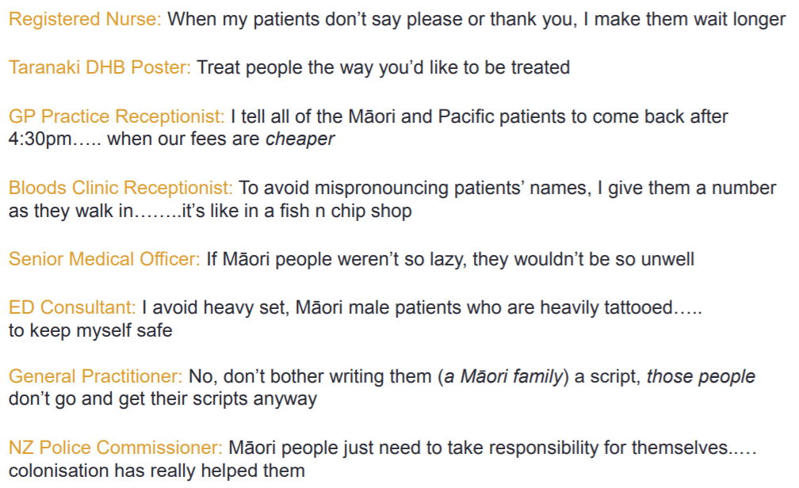
“But I treat everyone the same…
http://koawatea.co.nz/wp-content/uploads/2017/05/Engaging-Effectively-with-Maaori-2017-Hone-Hurihanganui_HeartsMinds-Ltd.pdf

Slide 19
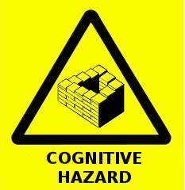
Deconstructing Our Biases?

Slide 20
“But I treat everyone the same…
Our default assumption should be that we will treat patients inequitably
This happens due to a complex interaction of factors related to the health system, health worker, the patient, setting and broader social dynamics
Critical consciousness
Reinforces the importance of explicit teaching and learning of cultural competence

Slide 21

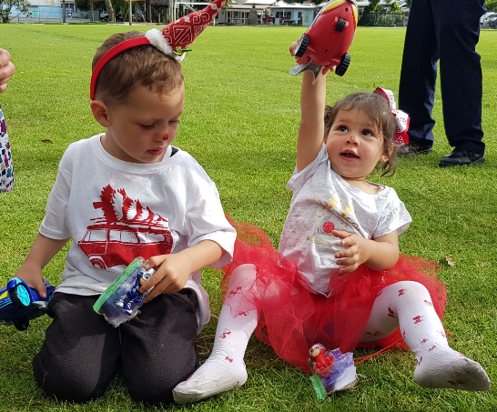
Ka marama ki roto , Ka tiaho ki waho
Hei Kaitiaki , Mauri ora e
What efforts of knowledge and compassion is planted in the heart , these shall be returned to us …. As hope, as breath , as life.
Mauri Ora window
Notes:
Where every you are in the world
May you feel of our spirit , may we be united as a human race through this trialling time.
May we be kind , safe and caring.
Tena Koutou Tena Koutou , Tena Koutou katoa

Slide 22
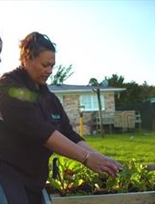
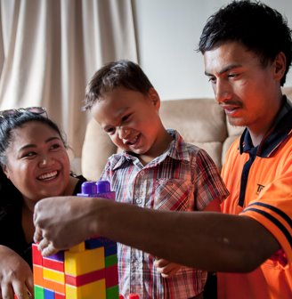

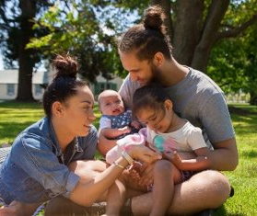
Mauri ora
Individuals and families flourishing

